Slide 1



Philip Tellis
@bluesmoon
Nic Jansma
@nicj
https://github.com/SOASTA/boomerang
http://www.soasta.com/mpulse
http://slideshare.net/nicjansma/measuring-real-user-performance-in-the-browser

Slide 2
Measuring Real User Performance in the Browser
2016-09-20
#VelocityCONF NY 2016
http://slideshare.net/nicjansma/measuring-real-user-performance-in-the-browser

Slide 3
Agenda
Real User Measurement
Browser Performance APIs
Visual Experience
Beaconing
Single Page Apps
Continuity
Nixing Noise

Slide 4
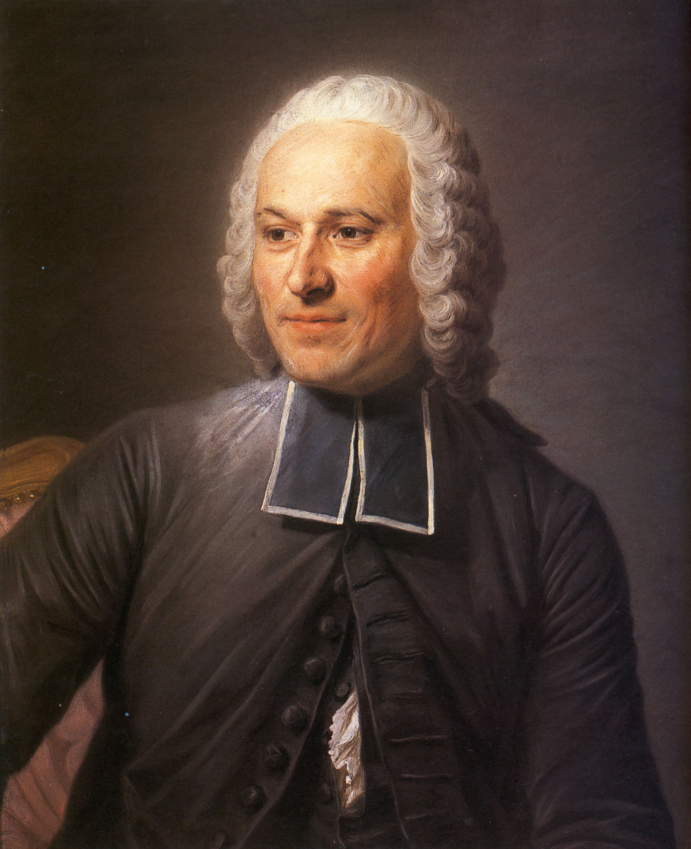
Abbé Jean-Antoine Nollet
1700 - 1770
French Clergyman & Budding Electrician
Invented one of the first Electroscopes
(we now call them beacon collectors)
L'Abbé Jean Antoine Nollet — Maurice Quentin de La Tour
Alte Pinakothek, Munich, Germany Public Domain

Slide 5
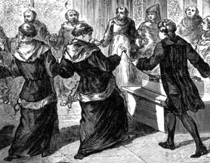
In 1746, he conducted the first ever RUM Experiment
He shot an electric current through 200 monks, and checked how quickly they jumped; thereby measuring the latency of an electric signal with…
Real Users!

Slide 6
Fortunately, our methods have gotten far less intrusive...

Slide 7
but first...
Why do we care?
Notes:
The head of marketing at a company we recently spoke to asked us, "Even if I knew that things were bad, what would I do about it? My job is just to run the campaign, not to fix it if it's broken."

Slide 8


Delight
Or
Frustrate
Notes:
A user experience has the ability to delight or frustrate, and the reaction to that experience can make or break our businesses.

Slide 9

Delight
Responsiveness
Experience
Smoothness
Cognitive Dissonance/Resonance
Frustration
Notes:
What goes into an experience?
Responsiveness, ie, How quickly or slowly the browser reacts to a user action (click, scroll, etc.)
Smoothness, ie How smooth interacting with the browser is (animation, scrolling, typing)
Cognitive dissonance, ie, the user tried to do something but something else happened

Slide 10
ok then...
How do we do it?

Slide 11
Performance aware Browser APIs
High Resolution Time: Better Date.now()
Navigation Timing (NT): Page load timings
Performance Timeline: Access NT/RT/UT from one API
Resource Timing (RT): Resource load timings
User Timing (UT): Custom site events and measurements
Page Visibility: Visibility state of the document
Timing control for script-based animations: requestAnimationFrame()
Efficient Script Yielding: setImmediate()
Resource Hints: dns-prefetch, preconnect, prefetch, prerender
Preload: Mandatory high-priority fetch for current navigation
Cooperative Scheduling of Background Tasks: requestIdleCallback()
Beacon: sendBeacon()

Slide 12
DOMHighResTimeStamp
High-resolution, monotonically non-decreasing clock
 | Date | DOMHighResTimeStamp
Accessed via | (new Date).getTime() | performance.now()
Start | Unix epoch | navigationStart
Monotonically non-decreasing | No | Yes
Affected by user’s clock | Yes | No
Resolution | Millisecond | Sub-millisecond
Example | 1420147524606 | 3392.275999998674
https://w3c.github.io/hr-time/
Notes:
(new Date).getTime();
performance.now();

Slide 13
DOMHighResTimeStamp
Monotonically non-decreasing
 | Date.getTime() | performance.now()
@ Navigation Start | 1420147524606 | 0
@ 100ms | 1420147524706 | 100.0
@ 200ms | 1420147524806 | 200.0
@ 300ms + user's clock moves back 1s | 1420147523906 | 300.0
@ 400ms | 1420147524006 | 400.0

Slide 14
DOMHighResTimeStamp: Usage
var myTime = performance.now(); // 8141.84 -> 8.1 seconds after page load

Slide 15
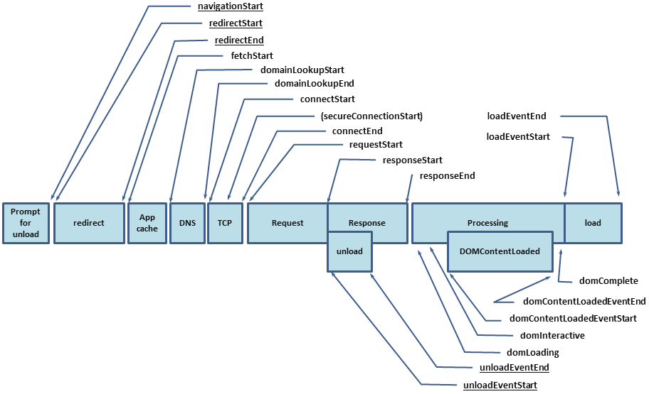
NavigationTiming
http://www.w3.org/TR/navigation-timing
Exposes accurate performance metrics describing your visitor's page load

Slide 16
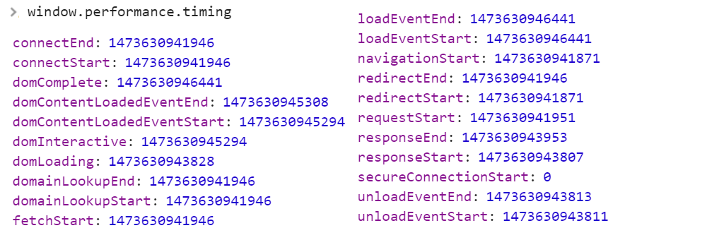
NavigationTiming: Timestamps
window.performance.timing
Navigation timestamps:
Notes:
performance.timing.navigationStart;
performance.timing.domainLookupStart - performance.timing.navigationStart;
performance.timing.domainLookupEnd - performance.timing.domainLookupStart;

Slide 17
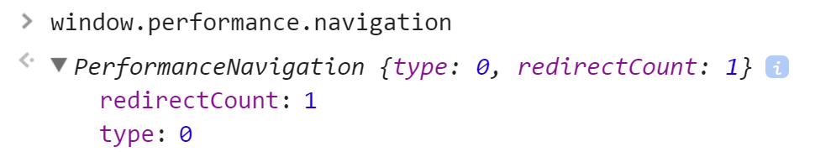
NavigationTiming: Characteristics
window.performance.navigation
Characteristics of the browser navigation
window.performance.navigation.type:
navigate = 0
reload = 1
back / forward = 2

Slide 18
NavigationTiming: Usage
function onLoad() { if ('performance' in window && 'timing' in window.performance) { setTimeout(function() { var t = window.performance.timing; var ntData = { redirect: t.redirectEnd - t.redirectStart, dns: t.domainLookupEnd - t.domainLookupStart, connect: t.connectEnd - t.connectStart, ssl: t.secureConnectionStart ? (t.connectEnd - secureConnectionStart) : 0, request: t.responseStart - t.requestStart, response: t.responseEnd - t.responseStart, dom: t.loadEventStart - t.responseEnd, total: t.loadEventEnd - t.navigationStart }; }, 0); } }

Slide 19
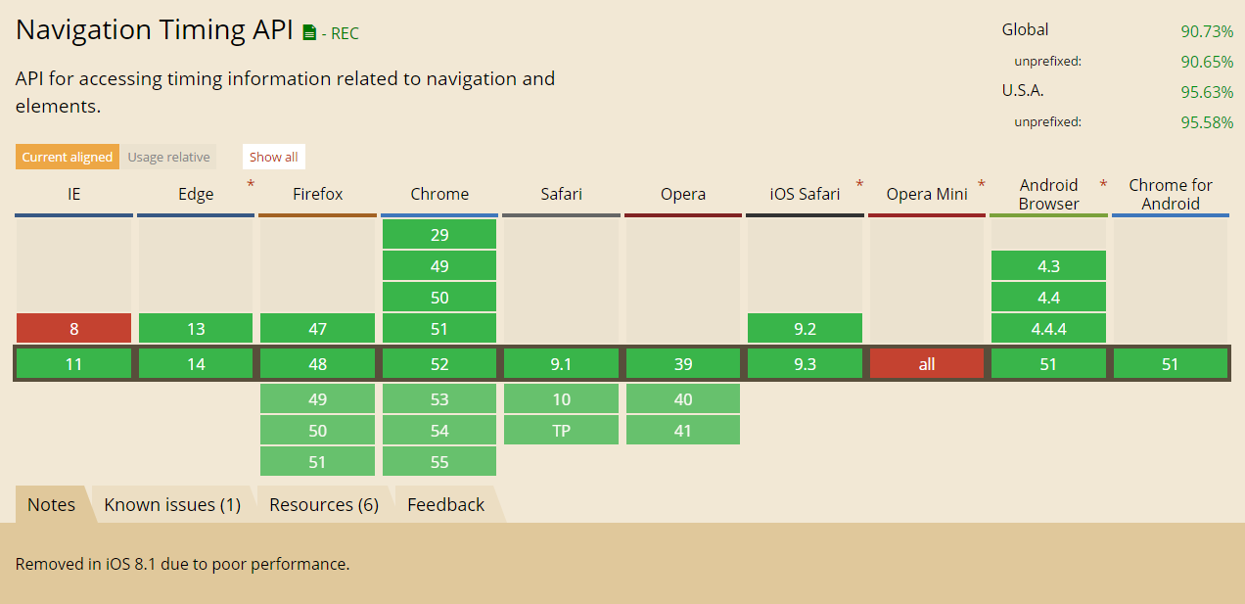
NavigationTiming: Browser Support

Slide 20
NavigationTiming: Integrations
DIY:
Send this data to your backend for logging
Show any page's timings via a bookmarklet: kaaes.github.io/timing
Boomerang: github.com/SOASTA/boomerang
Boomcatch: cruft.io/posts/introducing-boomcatch
BoomerangExpress: github.com/andreas-marschke/boomerang-express
SiteSpeed.io: sitespeed.io
Piwik: github.com/piwik/piwik
Commercial:
SOASTA mPulse, Google Analytics Site Speed, New Relic Browser, NeuStar WPM, SpeedCurve, etc...

Slide 21
NavigationTiming: Tips
Use fetchStart instead of navigationStart unless you're interested in redirects, tab initialization time, etc.
loadEventEnd will be 0 until after the body's load event has finished (so you can't measure it in the load event)
We don't have an accurate way to measure the "request time", as "requestEnd" is invisible to us (the server sees it)
Home page scenarios: Timestamps up through responseEnd event may be 0 duration because some browsers speculatively pre-fetch home pages (and don't report the correct timings)
If possible, do any beaconing of the data as soon as possible. Browser onbeforeunload isn't 100% reliable for sending data
Not suitable for Single-Page Apps (we’ll cover this later)
Notes:
Need examples of browsers where timestamps are 0, we should also mention what happens with pre-render

Slide 22
Coming Soon to NavigationTiming
Part of the Performance Timeline: performance.getEntries("navigation")
Support for DOMHighResTimeStamp
Timing information for prerender
Protocol information: nextHopProtocol
Transfer, encoded body and decoded body sizes

Slide 23
NavigationTiming: chrome.loadTimes()
{ "requestTime" : 1473093945.032975, "startLoadTime" : 1473093945.129178, "commitLoadTime" : 1473093945.575271, "finishDocumentLoadTime" : 1473093946.872513, "finishLoadTime" : 1473093952.281069, "firstPaintTime" : 1473093945.96769, "firstPaintAfterLoadTime": 1473093952.316622, "navigationType" : "BackForward", "wasFetchedViaSpdy" : true, "wasNpnNegotiated" : true, "npnNegotiatedProtocol" : "quic/1+spdy/3", "wasAlternateProtocolAvailable" : false, "connectionInfo" : "quic/1+spdy/3" }
Notes:
These aren't well documented

Slide 24
what did we do before NavigationTiming?

Slide 25
Prior to NavigationTiming
Hook into the beforeUnload, unload and pagehide events to set a cookie with the timestamp and url
In the onload or pageshow event, check if the cookie is set and if the url in the cookie matches document.referrer
If we have a match, calculate the time delta
beforeUnload corresponds to navigationStart
unload and pagehide correspond to responseStart
We also hook into clicks and form submits just in case the user goes off to a new tab
Note: This doesn't help for external referrers!
Notes:
Not going to spend too much time on legacy support, but if you're curious about the code, read the source of boomerang's rt.js

Slide 26
Surprisingly, this works all the way back to IE5.5
(insofar as we've tested)

Slide 27
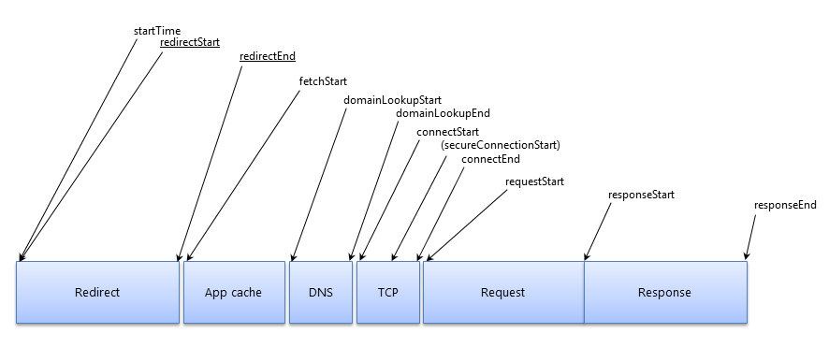
ResourceTiming
https://www.w3.org/TR/resource-timing/
Exposes sub-resource performance metrics

Slide 28
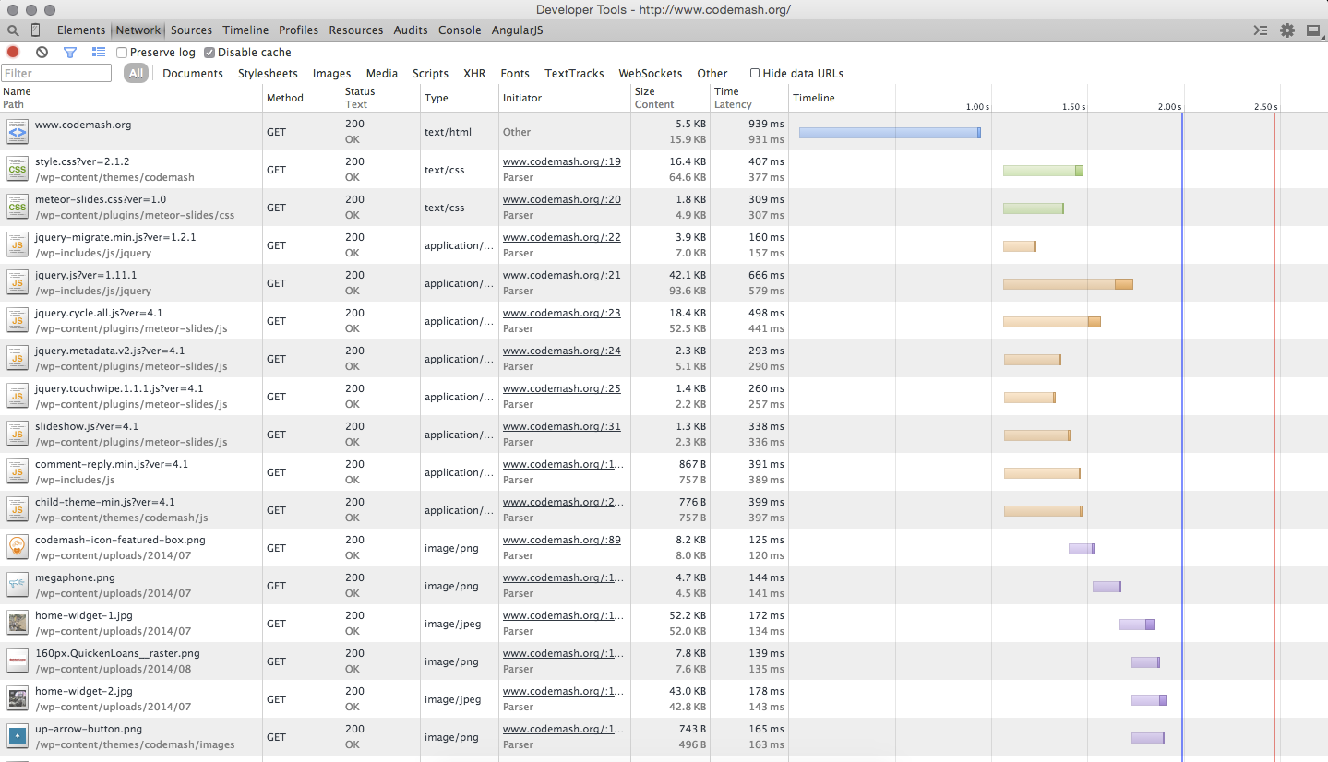
ResourceTiming: Inspiration

Slide 29
ResourceTiming: History
How it was done in the old days:
var start = new Date().getTime(); var image1 = new Image(); var resourceTiming = function() { var now = new Date().getTime(); var latency = now - start; alert("End to end resource fetch: " + latency); }; image1.onload = resourceTiming; image1.src = 'http://www.w3.org/Icons/w3c_main.png';
(not practical for all types of content -- or a regular HTML website)

Slide 30
PerformanceTimeline
Unifying interface to access and retrieve performance metrics
window.performance:
getEntries(): Gets all entries in the timeline
getEntriesByType(type): Gets all entries of the specified type (eg resource, mark, measure)
getEntriesByName(name): Gets all entries with the specified name (eg URL or mark name)

Slide 31
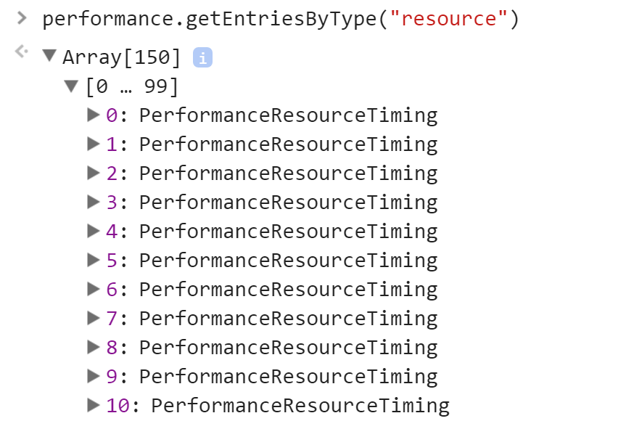
PerformanceTimeline: Usage

Slide 32
ResourceTiming: performance.getEntriesByType("resource")[0]
{ name : "http://www.foo.com/foo.png", initiatorType : "img", entryType : "resource", startTime : 566.357000003336,
workerStart : 0, redirectStart : 0, redirectEnd : 0, fetchStart : 566.357000003336, domainLookupStart : 566.357000003336, domainLookupEnd : 566.357000003336, connectStart : 566.357000003336, secureConnectionStart : 0, connectEnd : 566.357000003336, requestStart : 568.4959999925923, responseStart : 569.4220000004862, responseEnd : 570.6329999957234, duration : 4.275999992387369 }

Slide 33
ResourceTiming: InitiatorType
img
link
script
css: url(), @import
xmlhttprequest
image (SVG)
object (Flash)
localName of the element
Notes:
localName of the element

Slide 34
ResourceTiming: Buffer
There is a ResourceTiming buffer (per IFRAME) that stops filling after its size limit is reached (default: 150 entries)
Listen for the onResourceTimingBufferFull event
setResourceTimingBufferSize(n) and clearResourceTimings() can be used to modify it
Do NOT setResourceTimingBufferSize(99999999) as this can lead to browser memory growing unbound

Slide 35
ResourceTiming: Compressing
Each resource is ~ 500 bytes JSON.stringify()'d
HTTP Archive tells us there's 103 HTTP resources on average, per page, with an average URL length of 85 bytes
That means you could expect around 45 KB of ResourceTiming data per page load
For comparison, the default TCP Window size allows 15 KB to go through before requiring an ACK, so do the math.
Compress it: nicj.net/compressing-resourcetiming
Notes:
JSON.stringify(performance.getEntriesByType("resource"));
JSON.stringify(performance.getEntriesByType("resource")).length;

Slide 36
ResourceTiming: Compressing
{ connectEnd: 566.357000003336, connectStart: 566.357000003336, domainLookupEnd: 566.357000003336, domainLookupStart: 566.357000003336, duration: 4.275999992387369, entryType: "resource", fetchStart: 566.357000003336, initiatorType: "img", name: "http://www.foo.com/foo.png", redirectEnd: 0, redirectStart: 0, requestStart: 568.4959999925923, responseEnd: 570.6329999957234, responseStart: 569.4220000004862, secureConnectionStart: 0, startTime: 566.357000003336,
workerStart: 0 }
{ "http://": { "foo.com/": { "js/foo.js": "370,1z,1c", "css/foo.css": "48c,5k,14" }, "moo.com/moo.gif": "312,34,56" } }
Compresses ResourceTiming data down to 15% of original size
https://github.com/nicjansma/resourcetiming-compression.js

Slide 37
ResourceTiming: Timing-Allow-Origin
By default to protect the user's privacy, cross-origin resources expose timestamps for only the fetchStart and responseEnd attributes
If you have a CDN, or multiple domains, you can allow access to this data from your primary domain
Use the TAO:
Timing-Allow-Origin: origin-list-or-null OR *
Note: Third-party libraries (ads, analytics, etc) must set this on their servers. 5% do according to HTTP Archive. Google, Facebook, Disqus, mPulse, etc. What are the others afraid of?

Slide 38
ResourceTiming: Timing-Allow-Origin
// PHP <?php header('Timing-Allow-Origin: *'); ?> // JBoss protected void doPost(HttpServletRequest req, HttpServletResponse res) { res.setHeader("Timing-Allow-Origin", "*"); }
// Apache .htaccess <IfModule mod_headers.c> Header set Timing-Allow-Origin "*" </IfModule> // nginx location / { add_header 'Timing-Allow-Origin' '*'; }
And we can get more creative if we only want to allow specific Origins

Slide 39
ResourceTiming: Blocking Time
Browsers open a limited number of connections to each unique origin
If there are more resources than this number, later resources "block"
ResourceTiming duration includes Blocking time!
So, don't use duration... but this is all you get with cross-origin resources.
var waitTime = 0; if (res.connectEnd && res.connectEnd === res.fetchStart) { waitTime = res.requestStart - res.connectEnd; } else if (res.domainLookupStart) { waitTime = res.domainLookupStart - res.fetchStart; }
Notes:
Mention blocking time after payload comes back but the UI can't display it yet

Slide 40
ResourceTiming: Cache Hits
Cached resources will show up along side resources that were fetched from the network
Due to privacy concerns, no direct indication a resource was fetched from the cache
In practice, resources with a very short duration are likely cache hits
0 - 2ms → In memory cache
2 - 10ms → Disk cache
10 - 40ms → Cached by Edge Proxy
Notes:
Mention blocking time after payload comes back but the UI can't display it yet

Slide 41
ResourceTiming: Integrations
DIY:
Compress + send this data to your backend for logging
Show any page's resources via a bookmarklet: github.com/andydavies/waterfall
Heatmap bookmarklet / Chrome extension: github.com/zeman/perfmap
Nurun's Performance Bookmarklet: github.com/nurun/performance-bookmarklet
Boomerang supports ResourceTiming: github.com/SOASTA/boomerang
SOASTA mPulse, New Relic Browser, SpeedCurve, etc.
Pay:

Slide 42
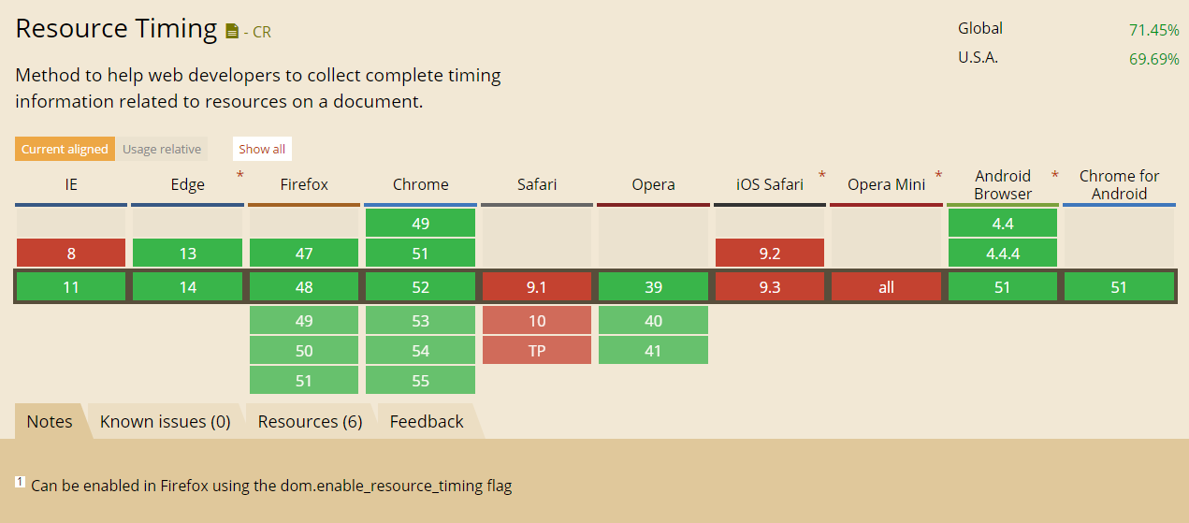
ResourceTiming: Browser Support

Slide 43
ResourceTiming: Polyfill
ResourceTiming isn't yet available on iOS, but you can polyfill it using MutationObserver:
Start a MutationObserver listening for new nodes with a src or href
Add load & error event listeners & a timeout to deal with cached resources
Once the load (or error) event has fired, you have the total load time for the resource (keep in mind that an error event might also fire on Network Error)
In addition, you'll want to instrument XMLHttpRequest (which won't be captured by MutationObserver):
Proxy the XMLHttpRequest object
Hook into .open() and .send() and add onreadystatechange listeners
Sample code: github.com/SOASTA/boomerang/blob/master/plugins/auto_xhr.js
Note: This doesn't give you detailed information such as DNS & TCP timings

Slide 44
ResourceTiming: Tips
Ensure your CDNs and third-party libraries send Timing-Allow-Origin
What isn't included in ResourceTiming:
The root HTML page (get this from window.performance.timing)
HTTP code (privacy concerns)
Content that loaded with errors (eg 404s) (browser inconsistencies)
If you're going to be managing the ResourceTiming buffer, make sure no other scripts are managing it as well
Each IFRAME will have its own ResourceTiming data, and those resources won't be included in the parent FRAME/document. So you'll need to traverse the document frames to get all resources
about:blank, javascript: URLs will be seen in RT data
You may see browser extensions fetching resources in RT data
Notes:
See boomerang.js for IFRAME traversal code

Slide 45
ResourceTiming2: Coming Soon
Available in recent Firefox, Chrome:
nextHopProtocol: ALPN Protocol ID (e.g. quic+http2)
transferSize: Bytes transferred for HTTP header and response
decodedBodySize: Size of the body after removing any applied content-codings
encodedBodySize: Size of the body after prior to removing any applied content-codings

Slide 46
UserTiming
Measuring in-page scripts and other things that don't fire events

Slide 47
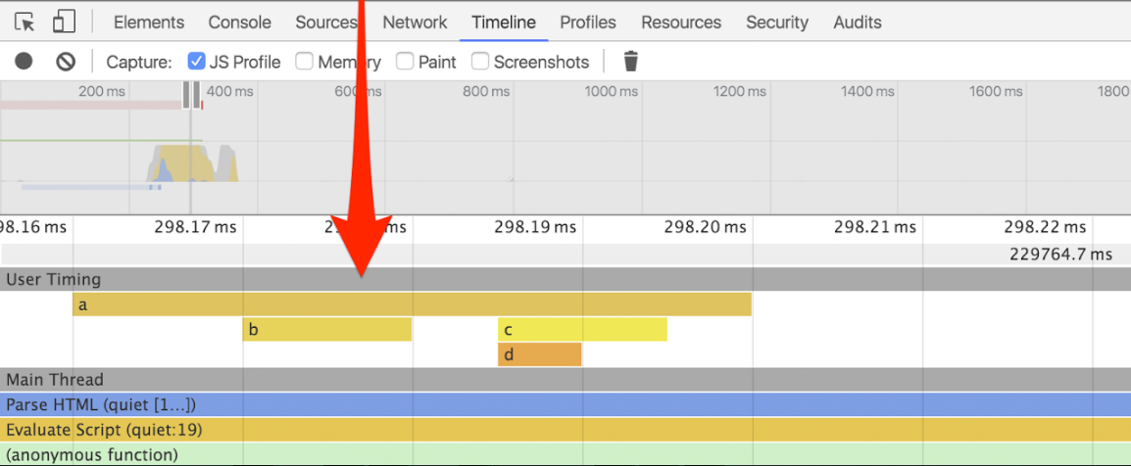
UserTiming
https://www.w3.org/TR/user-timing/
Standardized interface to note timestamps ("marks") and durations ("measures")

Slide 48
UserTiming: History
How it was done before:
var start = new Date().getTime(); // do stuff var now = new Date().getTime(); var duration = now - start;
UserTiming is a better way of doing this!

Slide 49
UserTiming: Marks & Measures
Mark: A timestamp
Measure: The delta between two timestamps

Slide 50
UserTiming: Usage
Creating:
window.performance.mark(name)
window.performance.measure(name, [start], [end])
Clearing:
window.performance.clearMarks([name])
window.performance.clearMeasures([name])
Querying:
window.performance.getEntriesByType("mark")
window.performance.getEntriesByType("measure")

Slide 51
UserTiming: Mark
// mark performance.mark("start"); performance.mark("end"); performance.mark("another"); performance.mark("another"); performance.mark("another");
// retrieve performance.getEntriesByType("mark"); [ { "duration":0, "startTime":150384.48100000096, "entryType":"mark", "name":"start" }, { "duration":0, "startTime":150600.5250000013, "entryType":"mark", "name":"end" }, ... ]
Notes:
DEMO

Slide 52
UserTiming: Measure
// measure performance.mark("start"); // do work performance.mark("start2"); // measure from "now" to the "start" mark performance.measure("time to do stuff", "start"); // measure from "start2" to the "start" mark performance.measure("time from start to start2", "start", "start2"); // retrieval - specific performance.getEntriesByName("time from start to start2", "measure"); [ { "duration":4809.890999997151, "startTime":145287.66500000347, "entryType":"measure", "name":"time from start to start2" } ]

Slide 53
UserTiming: Benefits
Uses the PerformanceTimeline, so marks and measures are in the PerformanceTimeline along with other events
Uses DOMHighResTimestamp instead of Date so timestamps are sub-millisecond, monotonically non-decreasing, etc
Browsers and third-party tools can find your performance events easily

Slide 54
UserTiming: Polyfill
It's easy to add a Polyfill that adds UserTiming support to browsers that do not natively support it
UserTiming is accessed via the PerformanceTimeline, and requires window.performance.now() support, so UserTiming.js adds a limited version of these interfaces if the browser does not support them
github.com/nicjansma/usertiming.js

Slide 55
UserTiming: Compressing
Compresses performance.getEntriesByName("mark"):
[{"duration":0,"entryType":"mark","name":"mark1","startTime":100.0}, {"duration":0,"entryType":"mark","name":"mark2","startTime":150.0}, {"duration":0,"entryType":"mark","name":"mark3","startTime":500.0}, {"duration":0,"entryType":"mark","name":"measure1","startTime":100.0}, {"duration":100,"entryType":"mark","name":"measure2","startTime":150.0}, {"duration":200,"entryType":"mark","name":"measure3","startTime":500.0}]
Down to something more reasonable:
~(m~(ark~(1~'2s~2~'5k~3~'8c)~easure~(1~'2s_2s~2~'5k_5k~3~'8c_8c)))
nicj.net/compressing-usertiming/
github.com/nicjansma/usertiming-compression.js

Slide 56
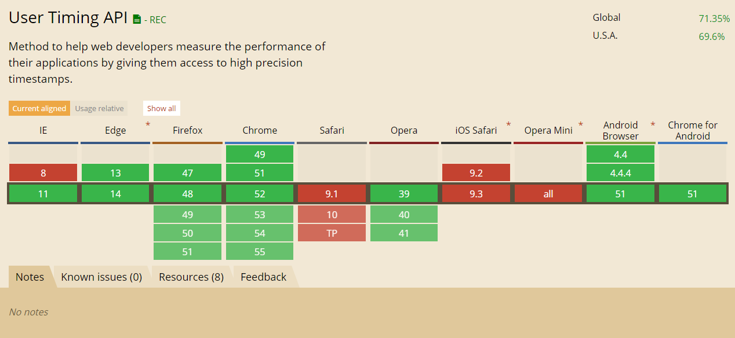
UserTiming: Browser Support

Slide 57
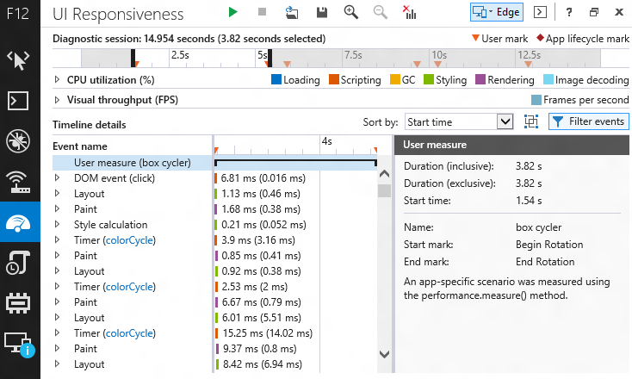
UserTiming: Dev Tools

Slide 58
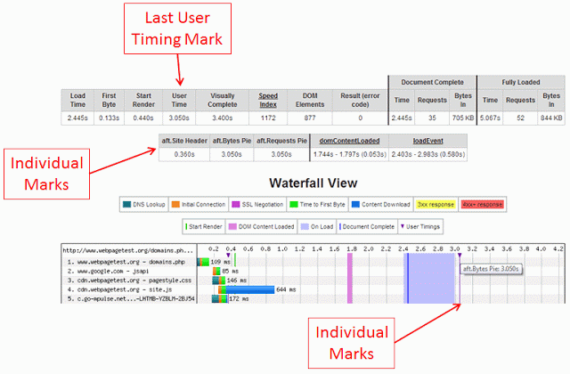
UserTiming: Dev Tools

Slide 59
Other Useful APIs
Visibility and Painting

Slide 60
PageVisibility
Lets you know when a webpage is visible or in focus.
document.visibilityState:
hidden
Browser is minimized
Background tab
About to unload or traverse session history
OS lock screen
visible
prerender
Being speculatively pre-rendered
Important for analytics!
unloaded

Slide 61
PageVisibility: Usage
// query the current state var state = document.visibilityState; // listen for state change events document.addEventListener("visibilitychange", function() { if (document.visibilityState === "hidden") { // stop doing something } else if (document.visibilityState === "hidden") { // restart doing something } });
Notes:
Demo
setInterval(function() { console.log(document.visibilityState); }, 100)

Slide 62
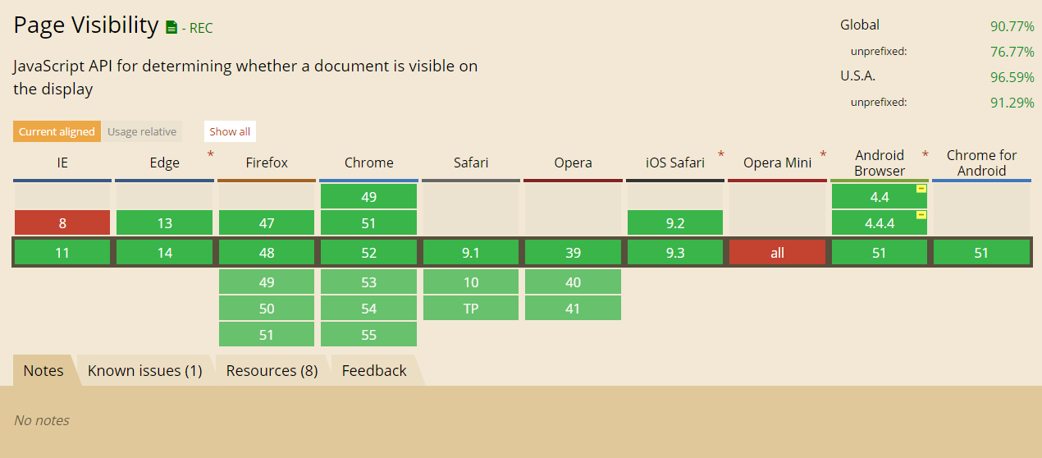
PageVisibility: Browser Support

Slide 63
requestAnimationFrame
Tells the browser you wish to run a function prior to the next repaint:
var last = performance.now(); function raf(timestamp) { var now = performance.now(); var diff = last - now; // update the UI based on the difference in time last = now; requestAnimationFrame(raf); } requestAnimationFrame(raf);
More examples when we talk about measuring continuity.

Slide 64
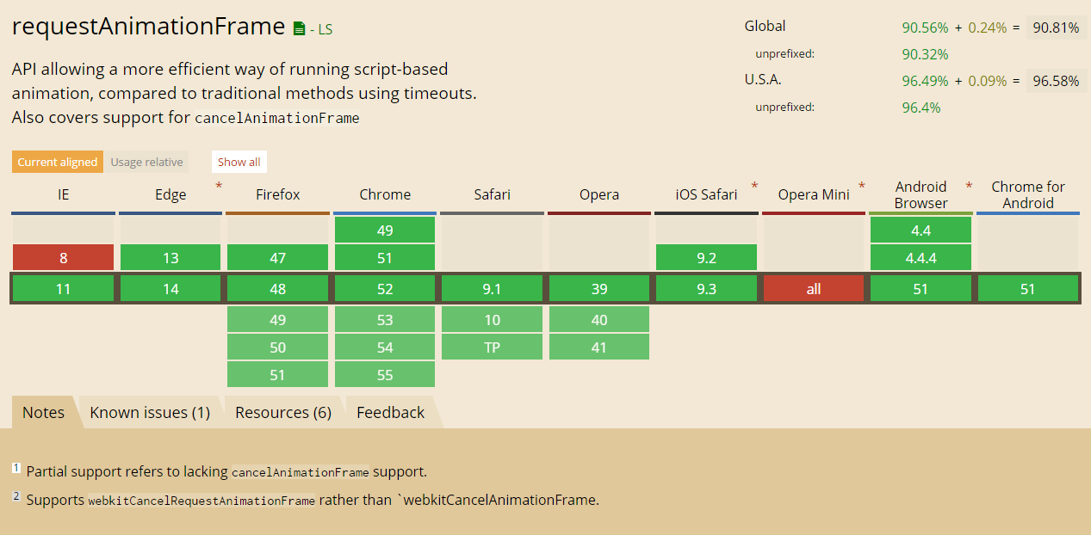
requestAnimationFrame: Browser Support

Slide 65
Page Load Milestones
First Byte
First content was received from the server
= responseStart
onload
Once all content statically included or injected before onload has been fetched
= loadEventStart
Fully Loaded
Once all static & dynamic content has been fetched
No browser event!

Slide 66
Visual Experience
When does the user feel like they can use the app?
Network timings != visual experience

Slide 67
Visual Experience
Milestones:
First Paint
First Contentful Paint
First Meaningful Paint
Visually Complete
Metrics:
Visual Progress
Speed Index

Slide 68

Visual Experience: First Paint
What was the first thing the user saw?
Notes:
This slide is meant to have a white image :)

Slide 69
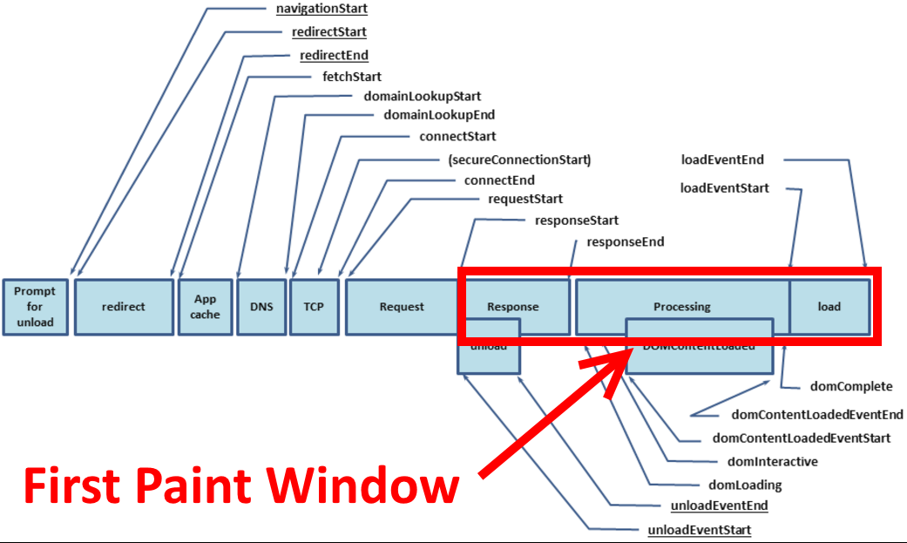
Visual Experience: First Paint
What was the first thing the user saw?

Slide 70

Visual Experience: First Paint
Not an industry standard metric!
The first paint of the browser might show zero content (all white)
// IE 9+ only window.performance.timing.msFirstPaint // -> 1473640901 // Chrome only window.chrome.loadTimes().firstPaintTime; // -> 1473640917.063874

Slide 71
Visual Experience: First Contentful Paint
First time a "contentful" thing is painted:
text
image
canvas
SVG
Could still be just a minor page element
e.g. just a navigation bar

Slide 72
Visual Experience: First Meaningful Paint
Page's primary content appears on screen
Primary content differs for each page
Definition still being developed, but this could be a heuristic, guided by hints from developers

Slide 73
Visual Experience: Visually Complete
All content has been displayed on the screen
Might be hard to measure with animations, ads, etc
Not the same as onload! Content can load after onload.

Slide 74
Visual Experience
Besides First Paint, none of these are available in browsers today:
First Contentful Paint
First Meaningful Paint
Visually Complete
Currently being developed into industry-standard definitions
Also options:
First Non-White (non-background) Paint
First Non-Blank Paint

Slide 75
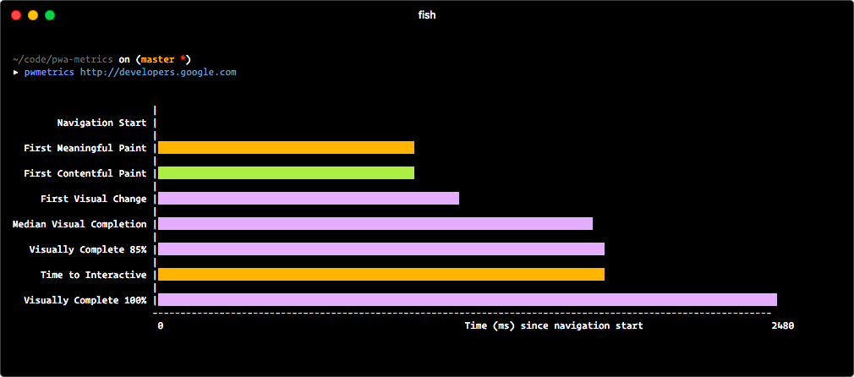
Progressive Web Metrics
Via Paul Irish: github.com/paulirish/pwmetrics

Slide 76
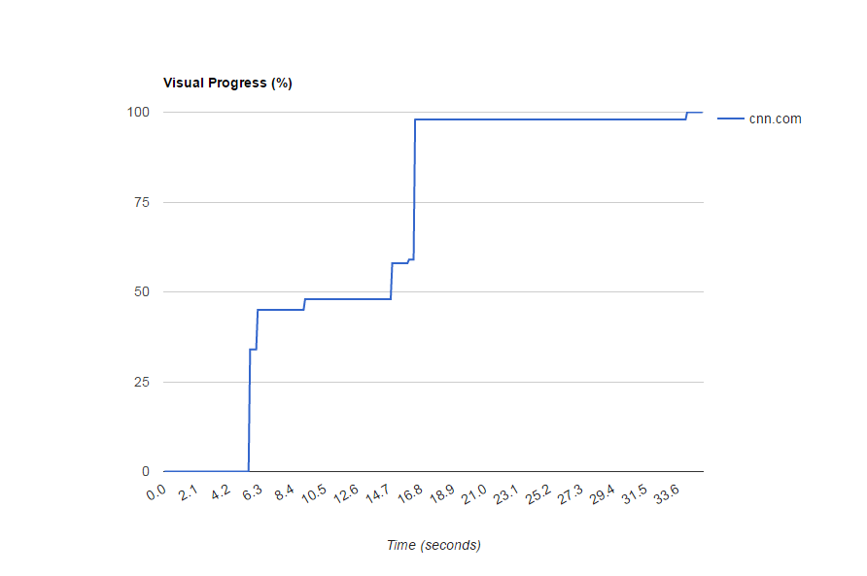
Visual Progress
Percentage of screen drawn over time (relative to last frame)
Notes:
Can't measure this in RUM today
Need synthetic testing

Slide 77
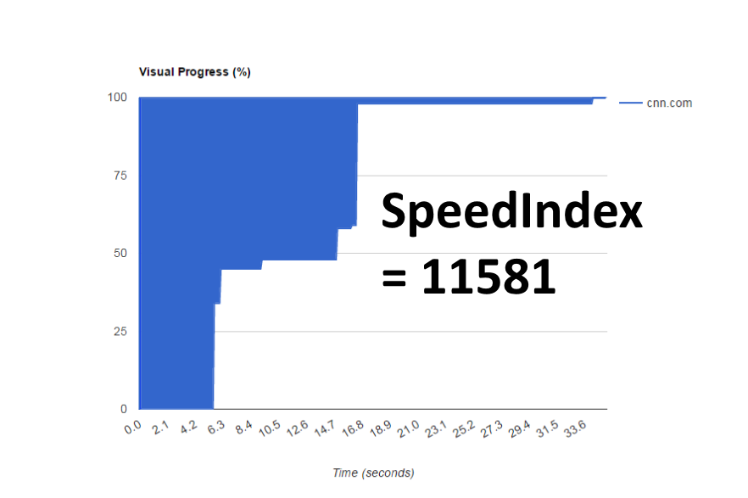
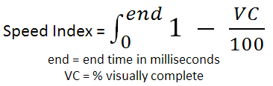
Speed Index
Average time at which visible parts of the page are displayed
Expressed in milliseconds
Area above the curve
Lower the better

Slide 78
Speed Index
Downsides:
Not very well understood
Can be hard to describe (even to techies! let alone marketing)
Can only be captured accurately in a lab (synthetic testing)

Slide 79
RUM Speed Index
Calculate Speed Index measurements from the field using Resource Timings
Depends on ResourceTiming support
Still being developed
Needs better support for IFRAMEs, SVGs, etc
github.com/WPO-Foundation/RUM-SpeedIndex

Slide 80
[ 30 minute break ]
http://slideshare.net/nicjansma/measuring-real-user-performance-in-the-browser

Slide 81
Single Page Apps

Slide 82
Single Page Apps (SPAs)
Run on a single page, dynamically bringing in content as necessary
Frameworks such as AngularJS, Ember.js, Backbone.js, React, etc.
Definitions
Hard Navigation: The first page load, which will include all static HTML, JavaScript, CSS, the SPA framework itself (e.g. angular.js), plus showing the initial route
Soft Navigation: Any subsequent route (address bar) change
Any URL might be loaded via either hard or soft navigation

Slide 83
SPAs...
3 Challenges

Slide 84
Challenge 1: The onload Event No Longer Matters
Traditional Websites:
On navigation, the browser begins downloading all of the JavaScript, CSS, images and other static resources
Once all static resources are fetched, the body's onload event will fire
This is traditionally what websites consider as page load complete

Slide 85
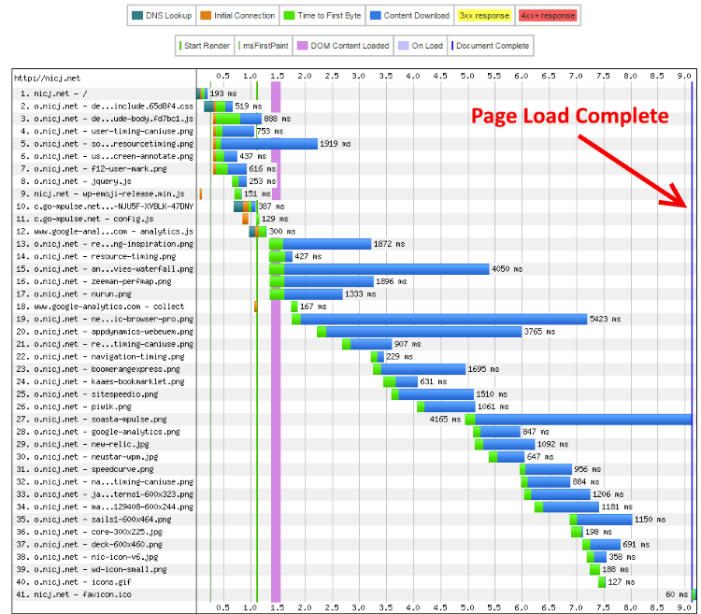
Challenge 1: The onload Event No Longer Matters

Slide 86
Challenge 1: The onload Event No Longer Matters
Single Page Apps:
Load all static content like a traditional website
The frameworks' code will also be fetched (e.g. angular.js)
(the onload event fires here)
Once the SPA framework is loaded, it starts looking at routes, fetching views and data
All of this content is fetched after the onload event

Slide 87
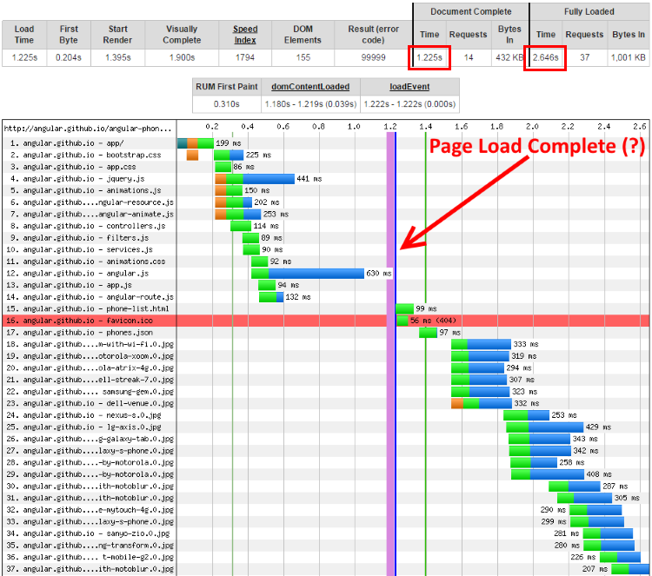
Challenge 1: The onload Event No Longer Matters

Slide 88
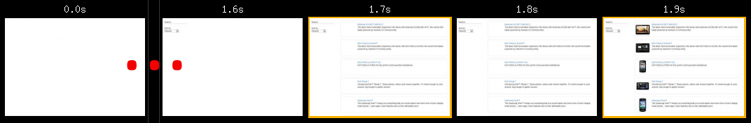
Challenge 1: The onload Event No Longer Matters
Browser fires onload at 1.225 seconds
All visual resources (.jpgs) aren't complete until after 1.7 seconds
Filmstrip confirms nothing is shown until around 1.7 seconds
onload fired 0.5 seconds too early!

Slide 89
Challenge 2: Soft Navs are not Real Navigations
This is great for performance
The browser is no longer re-rendering the same header, footer or common components
The browser is no longer re-parsing the same HTML, JavaScript and CSS
Bad for measuring:
Browser events (readyState, onload) and metrics (NavigationTiming) are all geared toward a single load event
Won't run again until the next time it loads on a full navigation

Slide 90
Challenge 3: Browser Won't Tell You When All Downloads Have Completed
The browser fires onload only once
The onload event helps us know when all static content was fetched
In a soft navigation scenario, the browser does not fire the onload event again, so we don't know when its content was fetched

Slide 91
Challenge 3: Browser Won't Tell You When All Downloads Have Completed
SPA soft navigations may fetch:
Templates
Images
CSS
JavaScript
XHRs
Videos

Slide 92
How to Measure SPAs
We need to figure out at what point the navigation started (the start event), through when we consider the navigation complete (the end event).

Slide 93
How to Measure SPAs: Start Event
Hard navigations:
Same as a traditional app - navigationStart
Soft navigations:
We need to figure out when the user's view is going to significantly change
The browser history is changing
SPA framework routing events can give us an indicator that the view will be changing
Other important events that might indicate a view change are a user click, or an XHR that triggers DOM changes

Slide 94
How to Measure SPAs: Start Event
SPA frameworks fire routing events when the view is changing:
AngularJS: $rootScope.$on("$routeChangeStart")
Ember.js: beforeModel or willTransition
Backbone.js: router.on("route")

Slide 95
How to Measure SPAs: Start Event
Clicks & XHRs:
To determine if a user click or XHR is really triggering a navigation, we can listen to what happens next
If there was a lot of subsequent network activity, we can keep on listening for more events
If history (address bar) changed, we can consider the event the start of a navigation
If the DOM was updated significantly, we can consider the event the start of a navigation
If nothing else happened, it was probably just an insignificant interaction

Slide 96
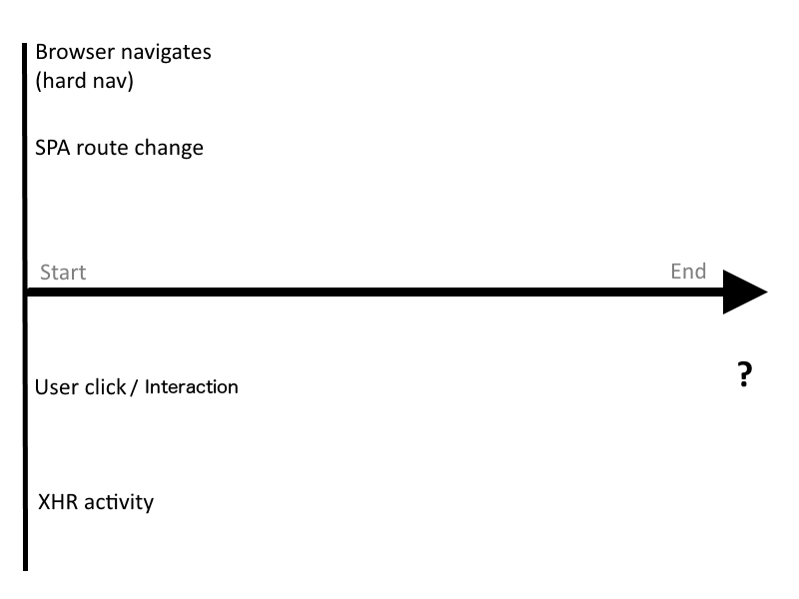
How to Measure SPAs: Start Event

Slide 97
How to Measure SPAs: End Event
When do we consider the SPA navigation complete?
When all networking activity has completed
When the UI is visually complete (above-the-fold)
When the user can interact with the page
Remember: onload doesn't work:
Only tracks static resources
SPA frameworks dynamically load other content
onload doesn't fire for Soft Navs

Slide 98
How to Measure SPAs: End Event
Let's make our own SPA complete event:
Similar to the body onload event, let's wait for all network activity to complete
This means we will have to intercept both implicit resource fetches (e.g. from new DOM elements) as well as programmatic (e.g. XHR) resource fetches

Slide 99
How to Measure SPAs: Monitoring XHRs
XHRs are used to fetch HTML, templates, JSON, XML, data and other assets
We should monitor to see if any XHRs are occurring
The XMLHttpRequest object can be proxied
Intercept the .open() and .send() methods to know when an XHR is starting
Listen to onReadyStateChange events to know when it's complete
github.com/lognormal/boomerang/blob/master/plugins/auto_xhr.js
Notes:
Then there are websites that violate the spec and call `open` and `send` multiple times on the same XHR object

Slide 100
How to Measure SPAs: Monitoring DOM Fetches
XHR is the main way to fetch resources via JavaScript
What about Images, JavaScript, CSS and other HTML elements that trigger resource fetches?
We can't proxy the Image object as that only works if you create a new Image() in JavaScript
If only we could listen for DOM changes...

Slide 101
MutationObserver
developer.mozilla.org/en-US/docs/Web/API/MutationObserver:
MutationObserver provides developers a way to react to changes in a DOM
observe() for specific events
Get a callback when mutations for those events occur

Slide 102
How to Measure SPAs: Monitoring DOM Fetches
Start listening when an XHR, click, route change or other interesting navigation-like event starts
Use MutationObserver to listen for DOM mutations
Attach load and error event handlers and set timeouts on any IMG, SCRIPT, LINK or FRAME
If an interesting element starts fetching keep the navigation "open" until it completes
After the last element's resource has been fetched, wait a few milliseconds to see if it kicked off anything else
If not, the navigation completed when the last element's resource was fetched
github.com/lognormal/boomerang/blob/master/plugins/auto_xhr.js

Slide 103
How to Measure SPAs: Monitoring DOM Fetches
What's interesting?
Internal and cached resources may not fetch anything, so you have to inspect elements first
IMG elements that haven't already been fetched (naturalWidth==0), have external URLs (e.g. not data-uri:) and that we haven't seen before
SCRIPT elements that have a src set
IFRAMEs elements that don't have javascript: or about: protocols
LINK elements that have a href set

Slide 104
How to Measure SPAs: Monitoring DOM Fetches
Why not ResourceTiming?
ResourceTiming events are only added to the buffer after they complete
In order to extend the SPA navigation end time, we have to know if any resource fetches are outstanding
We can use ResourceTiming later to supplement the data we get from XHR+MO

Slide 105
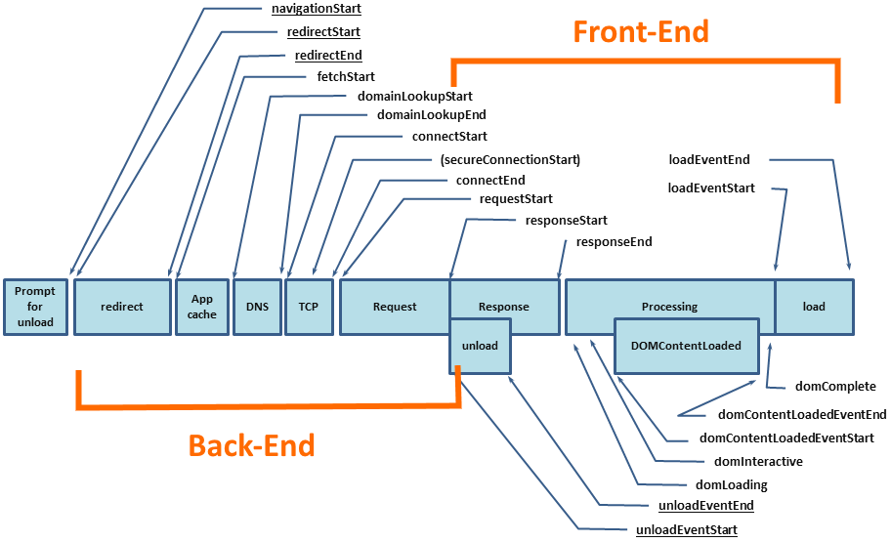
How to Measure SPAs: Front-End vs. Back-End
Traditional apps:

Slide 106
How to Measure SPAs: Front-End vs. Back-End
Traditional apps:
Back-End: HTML fetch start to HTML response start
Front-End: Total Time - Back-End
Single Page Apps:
Back-End: Any time slice with an XHR or SCRIPT outstanding
Since these are most likely critical path resources
Front-End: Total Time - Back-End

Slide 107
Accelerated Mobile Pages

Slide 108
AMP: Accelerated Mobile Pages
What is AMP?
A way to build web pages for improved performance
Restricts what you can put in your site to achieve this
Components:
AMP HTML: Similar to HTML5 with restrictions
AMP JavaScript: JavaScript library you include
Google AMP Cache: Free CDN
Restrictions
Cannot include any first- or third-party JavaScript

Slide 109
AMP: RUM
<amp-pixel src="http://…">
GET query URL
Substitution variables to gather metrics:
Document info (URL, Canonical URL, Title, Referer)
NavigationTiming (TCP, DNS, SSL, Page Load, etc)
Navigation Type and Redirect Count
Persisted Client ID
Total Engaged Time
Screen/Viewport dimensions
Example:
<amp-pixel src="http://myserver.com/beacon?u=AMPDOC_URL&t=PAGE_LOAD_TIME">

Slide 110
AMP: RUM
<amp-analytics>
AMP extension
Built in vendor configs (> 25)
Easy to configure
Predefined list of metrics is sent to vendor

Slide 111
Continuity

Slide 112
We measure everything up to navigation complete (page load or SPA nav)
We measure whether users bounce or convert
But
The bulk of user interaction and experience happens after navigation has completed

Slide 113
Which continuous variables can we measure and how?

Slide 114
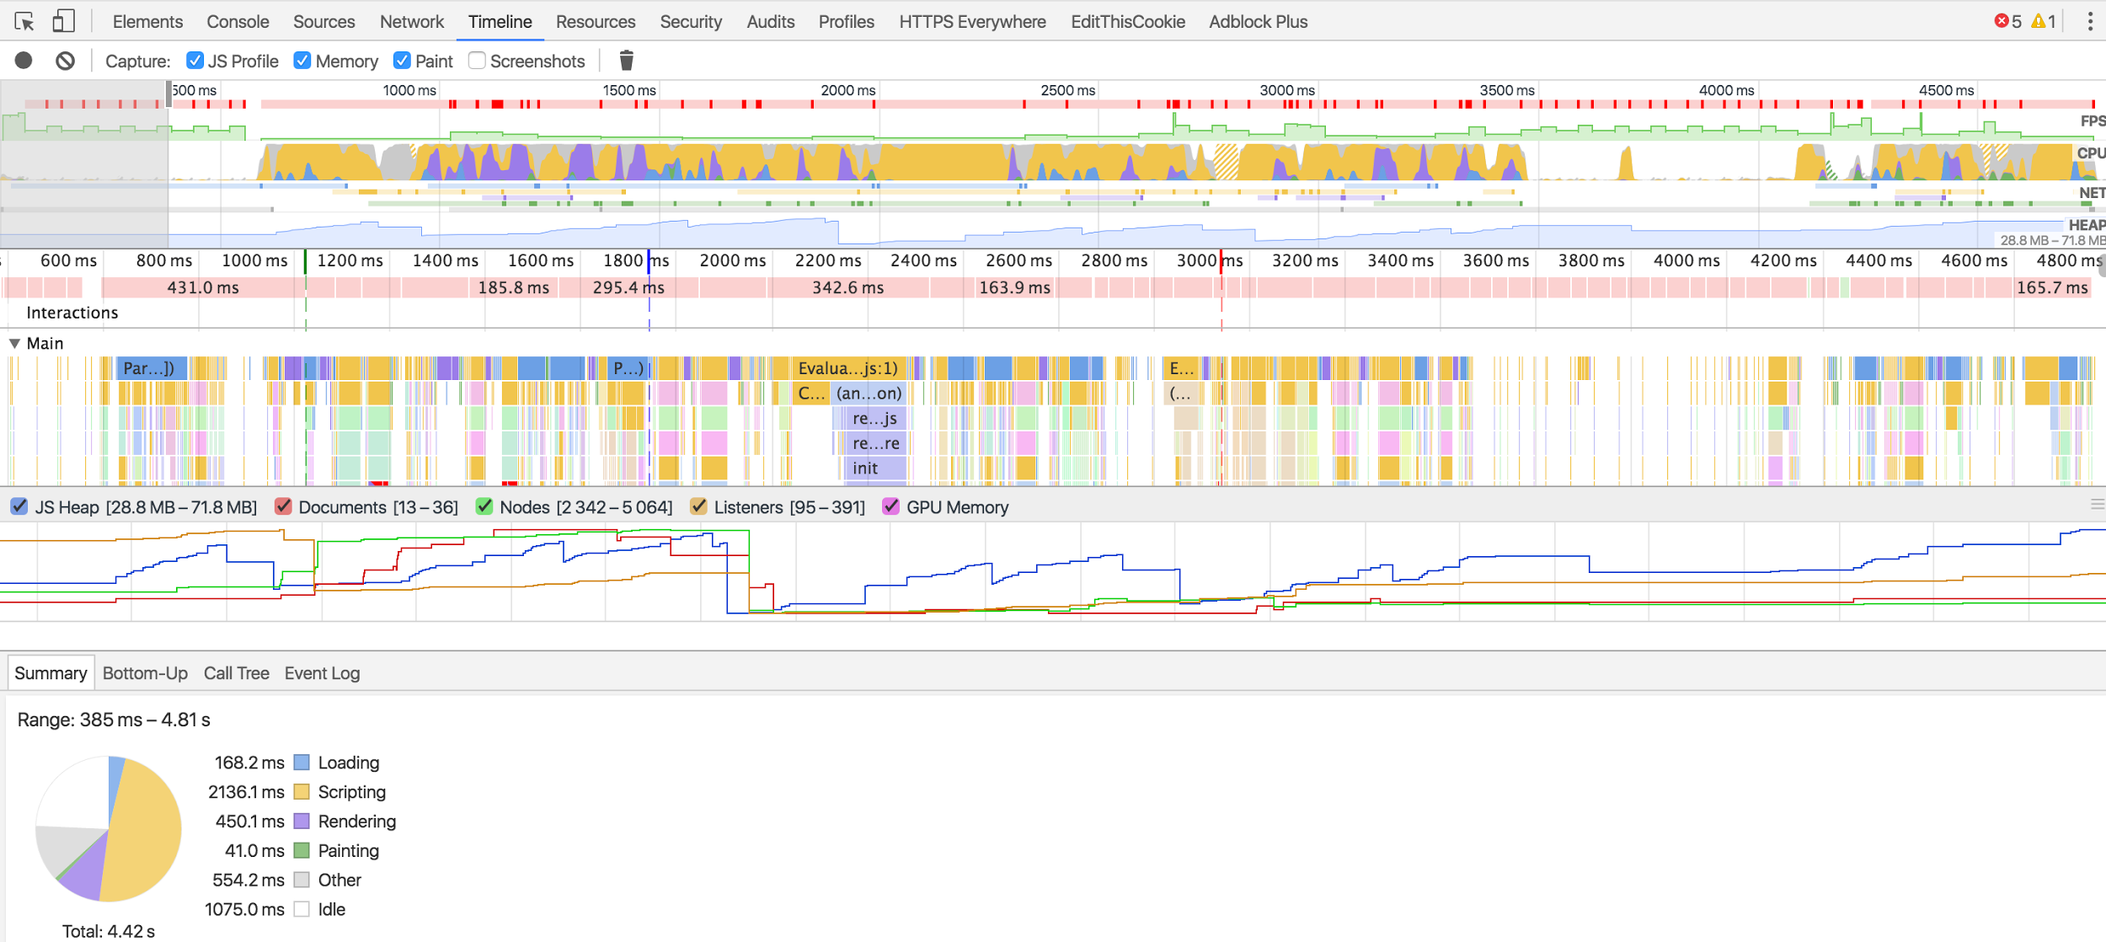
Developer Tools
Notes:
Let’s talk about how we can translate the data available in modern web browsers to the actual *experience* your visitors are getting after page load.
Everybody here probably has their favorite developer tools, right?
Here we see Chrome’s Developer Tools, which grow more and more powerful each year. As an application developer, we often want to try to collect “all the data” so we can get a sense of our visitor’s page load experiences. There is a treasure trove of information in dev tools. We use them to diagnose slow network activity, frame rates and JavaScript call stacks. The dev tools can be used for monitoring your app’s performance during development, but many of us would also like to collect similar data from our visitors in the wild too.
That’s what RUM is built around -- collecting performance metrics in aggregate to make decisions on how healthy your application is and alert when there are issues your customers are seeing.

Slide 115
Developer Tools
“The fact that something is possible to measure, and may even be highly desirable and useful to expose to developers, does not mean that it can be exposed as runtime JavaScript API in the browser, due to various privacy and security constraints”
— Performance APIs, Security and Privacy
https://w3c.github.io/perf-security-privacy/
Notes:
But we have to remember, there are tradeoffs to exposing the same level of details we get from dev tools have to JavaScript, where it could be captured by RUM. In fact, the W3C webperf WG has recently put out a note to address the ever-increasing pressure to try expose everything under the sun to JavaScript. [read quote].
It’s a very good article, and lays out a lot of the background privacy and security concerns for exposing more granular data than what we have today.

Slide 116
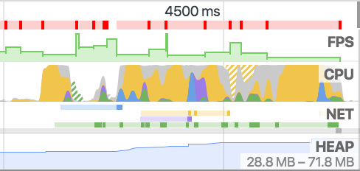
Continuity Metrics
Notes:
Here’s the good thing. One only has to start digging around the recent browser APIs to find a plethora of things you can measure about your visitor’s post-page-load experience. I’m going to show you can you can collect many of the same metrics that the Dev Tools expose today via JavaScript. They may not have the granularity you would expect to debug issues during development, but there’s plenty of information that can give you a sense of what you’re visitor’s experience is.
Let’s start out with the Dev Tools’ Timeline tab. The Timeline gives you an idea for how the app is performing over time, showing framerate, CPU usage, network activity and even memory data.
What can we gather today for RUM?

Slide 117
FPS - Frames Per Second
requestAnimationFrame(callback)
Callback is run before the next paint
// total frames seen this second var frames = 0; function measureFps() { frames++; // request a callback before the next frame window.requestAnimationFrame(measureFps); } // start measuring window.requestAnimationFrame(measureFps); // report on frame rate (FPS) once a second setInterval(function() { console.log("FPS: " + frames); frames = 0; }, 1000);
Notes:
Let’s start with the first item - frames per second, or FPS. The optimal framerate on most devices today is around 60, which is most screen’s refresh rate. Anything less than that, and you’ll start seeing “Jank”, or stuttering. Staying at a consistent 60 FPS is essential for giving your visitors a smooth experience. Luckily, we can easily measure FPS. There’s a browser API, requestAnimationFrame, whose callback will be called by the browser immediately before the next repaint. We don’t need to do any actual work here, we can just count “frames” by how often the callback is run each second.

Slide 118
FPS - Long Frames
Frames > 16.6 ms lead to < 60 FPS
var lastFrame = performance.now(); var longFrames = 0; function measureFps() { var now = performance.now(); // calculate how long this frame took if (now - lastFrame >= 18) { longFrames++; } lastFrame = now; window.requestAnimationFrame(measureFps); } window.requestAnimationFrame(measureFps); // report on long frames once a second setInterval(function() { console.log("Long frames: " + longFrames); longFrames = 0; }, 1000);
Notes:
Similar to overall frame rate in a timeline, you may also want to track the number of “long frames” that your application saw. Each long frame is a stuttery user experience. These are represented in the Chrome Developer tools as the “red” periods above. Using performance.now() to get a high resolution timestamp, we can see how many milliseconds it was since the last frame. Anything more than 16.6 milliseconds will miss the 60 FPS target.

Slide 119
FPS - Video
HTML5 VIDEO metrics (Chrome/FF)
var latestFrame = 0; var latestReportedFrame = 0; setInterval(function() { // find the first VIDEO element on the page var vids = document.getElementsByTagName("video"); if (vids && vids.length) { var vid = vids[0]; if (vid.webkitDecodedFrameCount || vid.mozPaintedFrames) { latestFrame = vid.webkitDecodedFrameCount || vid.mozPaintedFrames; } } console.log("Video FPS: " + Math.max(latestFrame - latestReportedFrame, 0)); // reset count latestReportedFrame = latestFrame; }, 1000);
Notes:
If you’re presenting video to the visitor through the HTML5 VIDEO element, there are some (non-standard) browser APIs you can also use to capture the FPS of video. Video FPS is dependent on the network delivering new frames and the device’s video pipeline decoding them, so it may differ from the overall browser FPS.

Slide 120
CPU - Page Busy
Browser doesn’t expose CPU metrics directly
Detect Busy by running a function at a regular interval
See if the callback runs at the time we expect
If the callback was delayed, the page was Busy
Busy can be caused by other JavaScript, layout, render, etc
Notes:
So that gives us some good parity to Developer Tools for monitoring frame rate over time. What about the next item, CPU?
This is a case where the data available in the Developer Tools is far beyond what we can measure from JavaScript. Obviously we can’t get detailed trace or stack information from JavaScript, nor even overall browser CPU usage, primarily due to performance and privacy concerns.
However, we can still get a small sense of how busy the page is by doing our own “profiling”. For example, if we configure a callback to run on a regular interval (say every 25 milliseconds), we can see how often that callback hits its mark exactly. If it does not -- if it’s delayed -- we can presume that it was delayed because of other work the browser was doing. For example, other JavaScript was running, or the browser was working on layout, rendering or other tasks for the page.
Over time, over an interval, we can see how often these callbacks are delayed. If 20% of callbacks didn’t fire on time, we can make an educated guess that the page was busy around 20% of that interval.
We call this Page Busy.

Slide 121
CPU - Page Busy
setInterval(function() { var now = performance.now(); var delta = now - last; last = now; // if we are more than 2x the poll // + deviation, we missed one period completely while (delta > ((POLLING_INTERVAL * 2) + ALLOWED_DEVIATION_MS)) { total++; late++; delta -= POLLING_INTERVAL; // adjust, try again } total++; if (delta > (POLLING_INTERVAL + ALLOWED_DEVIATION_MS)) { late++; } }, POLLING_INTERVAL);
Notes:
This certainly isn’t perfect, and we don’t get any detailed information about what was running or why we were delayed, but in testing this we’ve seen this metric correlate pretty heavily with what the Developer Tools report. And often, it matches the inverse of framerate.

Slide 122
NET - Resources
ResourceTiming
Bytes available in ResourceTiming2
var resources = window.performance.getEntriesByType("resource"); // number of resources fetched var resourceCount = resources.length; // number of bytes var bytesOverWire = 0; resources.forEach(function(res) { bytesOverWire += res.transferSize ? res.transferSize : 0; }); console.log("Resources: " + resourceCount + " " + bytesOverWire + "b");
Notes:
OK, so we’ve captured what we can from the CPU. Let’s take a look at what’s next, networking activity.
Luckily there’s already a lot of great information about the network exposed to JavaScript, primarily through the ResourceTiming interface. This interface reports on each resource fetched by the page. Doing some simple querying of the interface, and you can get rough stats like the number of resources fetched, and soon, content size and size over the wire.

Slide 123
HEAP - Memory Usage
Non-standard (Chrome only)
Reduced precision to avoid privacy concerns
// report on JS object memory once a second setInterval(function() { var mem = window.performance && window.performance.memory && window.performance.memory.usedJSHeapSize; console.log("Memory usage: " + mem); }, 1000);
Notes:
OK, the final graph in the Developer Tools Timeline is the Heap graph. This graph is great for showing the memory consumption of the page over time. It can point out excessive usage by your page’s components, and even possibly leaks over time.
There’s no standard browser APIs for reporting memory usage, but Chrome has a few counters on the performance.memory object. For example, you can see the used and total JavaScript Heap size.

Slide 124
Battery
Monitor your visitor’s battery state
Reduce work on low battery
setInterval(function() { navigator.getBattery().then(function(batt) { console.log(batt.level); }); }, 1000);
Notes:
Along the lines of other hardware metrics, you can also query the battery level from mobile devices.

Slide 125
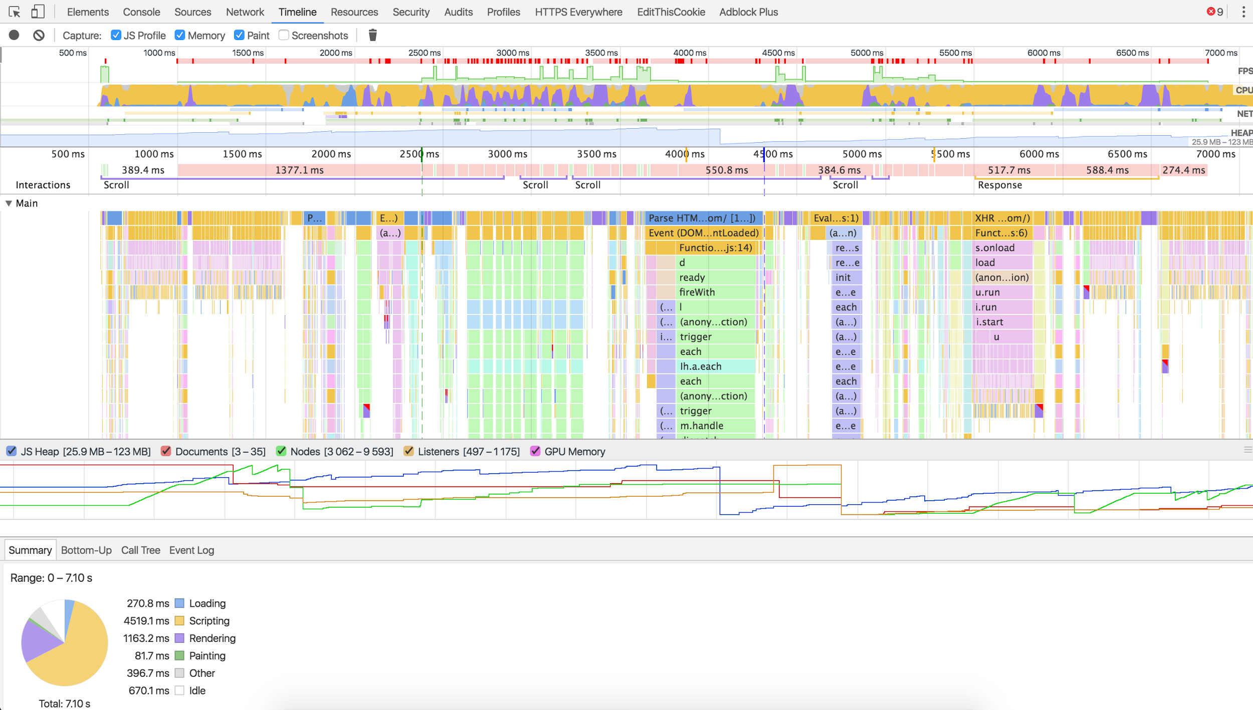
Interactions
Notes:
That covered the metrics-over-time graphs in the Timeline. What’s next?
Chrome also reports on User Interactions, and tracking these in your app is essential to annotating important events in your page’s lifecycle. Think of mouse movements and clicks, key presses and scroll events.
Keeping track of these user interactions is important because it will be useful later on to annotate important events in the app’s lifecycle. By monitoring what happens immediately after these user interactions, we can get a sense of how well your application performs in the face of change.

Slide 126
Interactions - User Input
scroll
mousemove
click
keydown
Notes:
Luckily monitoring for user interactions is really straightforward. For example, we can hook into the document’s “scroll” event and see how frequently, how far and how fast the user is scrolling around the page.
Similarly, you can hook into something like “keydown” and track the keys being pressed, etc.
Mouse movements and clicks are obviously the primary way your visitors interact with your site. We can listen for clicks, their target, and how often they’re happening to figure out how your visitor is behaving.
Similar to scroll events, we can monitor how quickly the mouse is moving, or how much of the screen it is covering.

Slide 127
Interactions - Visibility
Window’s visibility state
document.addEventListener("visibilitychange", function() { console.log(document.hidden ? "hidden" : "visible"); }, false);
Also look at the IntersectionObserver
https://developer.mozilla.org/en-US/docs/Web/API/Intersection_Observer_API
Notes:
Finally, it’s important to understand when the visitor is no longer interacting with your site. The Page Visibility API lets you determine if the document is “hidden”, and receive notifications when that state changes.

Slide 128
Interactions - Orientation
How the device is being held
window.addEventListener("orientationchange", function() { console.log("orientation: " + screen.orientation.angle); });
Notes:
From the hardware perspective, we can even determine some important state changes such as a transition from layout to portrait (or even frequent switching between the two).

Slide 129
Size Metrics
Notes:
That wraps up tracking what the user’s doing. What about the construction of the document? How does its’ complexity change over time?
The Chrome Developer Tools track heap, documents, nodes, listeners and GPU memory over time. We’ve already shown that we can track heap (with some browsers), what about the rest?

Slide 130
Size - Nodes
HTML size (bytes)
Overall Node count
IFRAME, IMG, SCRIPT, etc., node count
Notes:
Tracking the document’s complexity over time can give you insight why some of the other metrics are behaving. For example, as the size of the HTML document increases, it’s more likely you’ll be hitting issues with framerate or Page Busy as the browser spends more time parsing and laying out the document.
Using getElementsByTagName() you can track how many nodes there are in the DOM, or even get a breakdown of images, JavaScript, IFRAMEs, etc. Calculating the innerHTML length let’s you see how many bytes it takes to construct the root frame.

Slide 131
Size - DOM Changes
MutationObserver == change over time
var d = document; var mutationCount = 0; var domLength = d.getElementsByTagName("*").length; // create an observer instance var observer = new MutationObserver(function(mutations) { mutations.forEach(function(mutation) { if (mutation.type !== "childList") { return; } for (var i = 0; i < mutation.addedNodes.length; i++) { var node = mutation.addedNodes[i]; mutationCount++; mutationCount += node.getElementsByTagName ? node.getElementsByTagName("*").length : 0; } }); }); // configure the observer observer.observe(d, { childList: true, subtree: true });
Notes:
If you were to only track the number of nodes in the document, you may be missing other important periodic changes that are happening. Every DOM modification, insertion or deletion will cause the browser to do work. We can use a MutationObserver to get a lightweight notification of changes as they’re happening in real-time.
Counting the number of mutations as a percentage of the overall DOM node count can give you an indication into what percentage of the screen is changing on a periodic basis.

Slide 132
Errors
var errorCount = 0; window.onerror = function () { errorCount++; } setInterval(function() { console.log("Errors: " + errorCount); errorCount = 0; }, 1000);
Notes:
Finally, it’s we can hook into the browser’s onerror event to monitor for JavaScript errors as they happen in real-time.
Obviously every JavaScript error is an opportunity to break your user’s experience, so you may want to track and trend on these over time, especially after your users have interacted with your site.
Similarly, you can monitor the networking stack for request errors and report on these.
Error tracking and alerting is a huge topic on its own, but is an important part of measuring the user’s overall experience.

Slide 133

Demo
github.com/SOASTA/measuring-continuity
Notes:
To prove all of these metrics work, we’ve built a GreaseMonkey script that shows a realtime timeline of FPS, Page Busy, Interactions, DOM sizes, etc over time, and graphs them with Rishaw. You can get it at the Github repo listed.

Slide 134
So what?
Raw data != useful metrics
Let’s measure the user experience
Smoothness
Responsiveness
Reliability
Emotion
Notes:
OK, so we just went over a bunch of metrics that we can gather over time to monitor how your application is behaving. So what? Most of these metrics aren’t necessarily interesting on their own. For example, your user clicked something! And then scrolled! Hooray!
Obviously, gathering these types of metrics on their own can be helpful in tracking a user experience, but they’re not the only story.
How can we combine these metrics to tell a better story of how your user enjoyed -- or hated -- your site?
How smooth was your page? How responsive?
How reliable was it?
What was your visitor feeling?

Slide 135

Smoothness - FPS during scroll
FPS during page load
Notes:
Let’s start with framerate. On it’s own, it’s just a number. 60 FPS.
Over time, it tells a story. What was the framerate during the page load? What was the framerate while the user was scrolling? What was the framerate immediately after a user action like a button click? All of these are critical events in your visitor’s experience, and the framerate is one indicator to how smooth of an experience they’re having.
For any site that has content below the fold, the scrolling experience is where your site can shine, or, leave a bad impression with your visitors.
Simon Hearne built a wonderful bookmarklet that will use rAF to monitor the FPS while it forcefully scrolls your screen. It monitors the FPS until it hits the scroll bottom, and reports on the FPS over time.
As one example, this site drops below 60 FPS several times during scrolling. You can feel it. The site fees sluggish and jittery. Towards the end of the page it starts to reach 60 FPS but there are still a few periods that drop it to ~10 FPS because of a periodic timer that modifies the DOM.

Slide 136

Smoothness - FPS after interaction
Notes:
Besides scrolling, the user is probably interacting with your site in many ways through clicking, scrolling and moving the mouse around. It’s important to monitor FPS immediately after these interactions. These are guaranteed points the user is paying attention to what’s going on, and you want to provide the best experience during these periods.

Slide 137
Responsiveness
How long it takes for the site to respond to input?
requestAnimationFrame to detect next paint
MutationObserver to detect DOM changes
UserTiming to monitor your own code
SPA instrumentation via boomerang
Strive to give feedback within 100 milliseconds of a user interaction!
Notes:
Besides how smooth the experience is, what about how good your site responds to user input?
After we’ve detected a click, key or scroll, what happens next to the site? How long does it take for the site’s content to change so that the user is sufficiently confident their action resulted in the site responding?
You may have already instrumented your own code using something like UserTiming. UserTiming gives you a convenient way to measure important events in your page’s lifecycle.
We could also use something like MutationObserver to detect how long it took the DOM to change after the user’s interaction.

Slide 138
Responsiveness
document.addEventListener("click", function(e) { var start = performance.now(); requestAnimationFrame(function() { var delta = performance.now() - start; console.log("Click responsiveness: " + delta); }); }, false);

Slide 139
Responsiveness: Long Task API
https://github.com/spanicker/longtasks
Call a callback whenever a task takes too long to complete

Slide 140
Reliability
JavaScript errors
Leaks:
JavaScript memory usage over time
DOM size increase over time
Notes:
Finally, it’s critical to ensure your site doesn’t have any reliability issues as the user is interacting with it.
Obviously, tracking JavaScript errors is a core way of monitoring your site’s reliability. But with the other metrics we’re tracking like DOM size and memory usage over time, we can monitor for leaks in your site’s code. Small leaks may not immediately affect a new visitor’s experience, but as cheap mobile devices proliferate throughout the world, we want to make sure we’re as efficient as possible.

Slide 141
Tracking Emotion
Notes:
But again -- how do all of these metrics communicate how your user feels?
What are they going to take away from their experience on your site? Will they come back? Were they satisfied or angry?
What if we could track emotion?
Today, along with new technology specially developed by the NSA, we’re proud to announce the new Emotion Tracking API… just kidding.

Slide 142
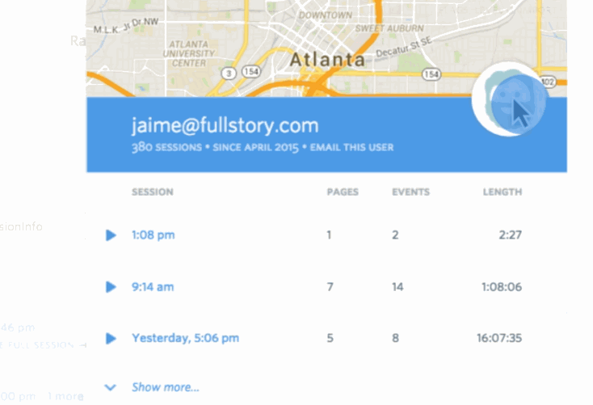
Rage Clicks
Rage clicks are series of clicks in which your users are pummeling their mouse buttons in frustration. It’s like punching your site in the face, usually because it’s not doing what the user wants or expects it to.
— Caitlin Brett, FullStory
blog.fullstory.com/moar-magic-announcing-rage-error-and-dead-clicks-1f19e50a1421
Notes:
Let’s start out with something simple. How can you detect that your visitor isn’t getting the interaction they expect out of your site?
Take clicking on a button as an example. Most people expect some sort of visual feedback that the button was clicked. A “pressed” indicator, or, some other sort of visual feedback.
But what if something is broken, and the button isn’t working? Most people’s first reaction is to wait a little bit, and try again -- thinking they were the issue.
By simply tracking where and how quickly the mouse is being clicked, especially on the same element, you might not only get reports of where your site is broken, but even where your site just isn’t working as the user expects.

Slide 143
Rage Clicks
var same = 0, x = 0, y = 0, targ = null; document.addEventListener("click", function(e) { var nX = e.clientX; var nY = e.clientY; // calculate number of pixels moved var pixels = Math.round( Math.sqrt(Math.pow(y - nY, 2) + Math.pow(x - nX, 2))); if (targ == e.target || pixels <= 10) { same++; } else { same = 0; } console.log("Same area clicked: " + same); x = nX; y = nY; targ = e.target; }, false);

Slide 144
Dead Clicks
Clicking without any meaningful visual (DOM) change
Might happen during (or right after) page load due to delayed JavaScript
Notes:
Similar to rage clicks, what about dead clicks -- clicks on a non-interactive element on your site.
Maybe you have something that looks like a link, but isn’t? Maybe your design is missing a key convention that users expect?
Dead clicks can help you detect when a click didn’t result in any meaningful change.
One easy way to detect Dead Clicks is by listening to the clicks and then network activity and Mutations. If neither a network request nor a DOM change happened, it’s possible that you’ll want to investigate exactly what the user’s clicking.
Now not all clicks are from people wanting to interact with your site. Some people click for no reason, because they’re click-happy, or may even read the page by highlighting text.

Slide 145
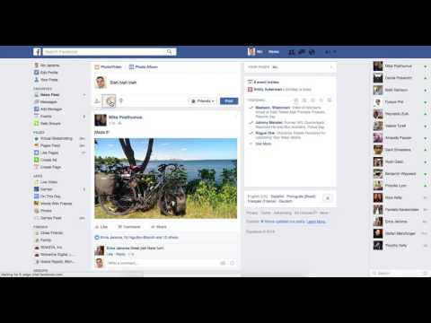
Dead Clicks
Notes:
Similar to rage clicks, what about dead clicks -- clicks on a non-interactive element on your site.
Maybe you have something that looks like a link, but isn’t? Maybe your design is missing a key convention that users expect?
Dead clicks can help you detect when a click didn’t result in any meaningful change.
One easy way to detect Dead Clicks is by listening to the clicks and then network activity and Mutations. If neither a network request nor a DOM change happened, it’s possible that you’ll want to investigate exactly what the user’s clicking.
Now not all clicks are from people wanting to interact with your site. Some people click for no reason, because they’re click-happy, or may even read the page by highlighting text.

Slide 146
Missed Clicks
User clicks near an element, but misses it
Notes:
This happens when click targets are hard to hit

Slide 147
Mouse Movement
“People who are angry are more likely to use the mouse in a jerky and sudden, but surprisingly slow fashion.
People who feel frustrated, confused or sad are less precise in their mouse movements and move it at different speeds.”
— Inferring Negative Emotion from Mouse Cursor Movements
Martin Hibbeln, Jeffrey L. Jenkins, Christoph Schneider, Joseph S. Valacich, and Markus Weinmann
Notes:
There’s been a study by BYU researchers on mouse movements. [read above]

Slide 148
Trusting Your Data
Notes:
Is the data trustworthy? What can we do to make sure it is, or at least be able to identify the good from the bad

Slide 149
Avoiding the Observer Effect
JavaScript is Single Threaded (per domain)
Unless the browser is idle, anything you do in JavaScript will slow down some other JavaScript
So how do we measure performance without affecting performance?

Slide 150
Avoiding the Observer Effect
Use the IFrame Loader Technique to load measurement code outside the critical path OR Load measurement code after the onload event (but then you can't measure things that happen before onload)

Slide 151
Avoiding the Observer Effect
Do as little as possible in event handlers, eg, read a timestamp or save state to a variable
Do more expensive processing of this data via a requestIdleCallback that runs when the browser is idle
requestIdleCallback is only available on Chrome and Opera at the moment, so use a shim for other browsers
requestIdleCallback API Spec: MDN://docs/Web/API/Window/requestIdleCallback
Complete, spec compliant SHIM: github://aFarkas/requestIdleCallback
Minimal Google SHIM (not entirely compliant): github://github/requestIdleCallback

Slide 152
Avoiding the Observer Effect
The unload event is a bit problematic because nothing can be deferred from it, so KiSS*, like writing to localStorage
Anything else should be run deferred from an onBeforeUnload handler (which is non-standard and not supported everywhere)
Also stay away from the scroll event or debounce/throttle
https://css-tricks.com/debouncing-throttling-explained-examples/
KiSS: Keep it Short & Simple

Slide 153
and whatever you do...
Flash!
Never Instrument

Slide 154
Beaconing
the mechanics of getting performance data back to you

Slide 155
How to Beacon
There are several methods for sending ("beaconing") data:
Image beacon
Form beacon
XMLHttpRequest beacon
Beacon API

Slide 156
Image Beacon
Create an <IMG> element from JavaScript with your query string data
<script> var img = new Image(); img.src = "http://myserver.com/beacon?pageLoad=100&dns=30"; // your data has been sent! </script>
Pros:
Easy and lightweight!
100% browser support
Hint: Return a 204 No Content HTTP response

Slide 157
Image Beacon
Cons:
Must put data on the query string (no POST)
URL length (payload) limitation:
Windows IE 6-8: 2083 b
Windows Chrome, Safari, Opera, Firefox, IE9+: >100 kb
Mac: Chrome, Opera, Firefox, Safari: >100 kb
Android Chrome, Opera: 81,500 b
iOS Safari, Chrome: >100 kb
Proxies? Beware

Slide 158
Image Beacon: URL Limit
Need to update your server config config for >8 KB URLs:
// Apache // https://httpd.apache.org/docs/2.2/mod/core.html#limitrequestline // Default: LimitRequestLine 8190 LimitRequestLine 16380 // nginx // https://nginx.org/en/docs/http/ngx_http_core_module.html#large_client_header_buffers // Default: large_client_header_buffers 4 8k; large_client_header_buffers 4 16k; // JBoss // https://docs.jboss.org/jbossweb/2.1.x/config/http.html // Default: maxHttpHeaderSize="8192" <Connector ... maxHttpHeaderSize="16384"/>

Slide 159
Form Beacon
Create a <FORM> element, POST it to a hidden IFRAME
var iframe, name = "beacon-" + Math.random(); try { // IE <= 8 iframe = document.createElement('<iframe name="' + name + '">'); } catch (ignore) { // everything else iframe = document.createElement("iframe"); } form.action = "https://my-server.com/beacon"; form.target = iframe.name = iframe.id = name; iframe.style.display = form.style.display = "none"; iframe.src = "javascript:false"; remove(iframe.id); remove(form.id);
document.body.appendChild(iframe); document.body.appendChild(form); try { form.submit(); } catch (ignore) {}
function remove(id) { var el = document.getElementById(id); if (el) { el.parentNode.removeChild(el); } } // cleanup setTimeout(function() { remove(iframe.id); }, 10000);
https://github.com/SOASTA/boomerang/blob/master/boomerang.js#L710-L761

Slide 160
Form Beacon
Server Implementation:
IE 10 can hang if given a 200 response. For best compat:
204 No Content
Content-Length: 0
Content-Type: image/gif
X-XSS-Protection: 0
Timing-Allow-Origin: *
To be able to capture ResourceTiming data
Access-Control-Allow-Origin: [*|domain]
If sent from another origin

Slide 161
Form Beacon
Pros:
POST data > 2,083 bytes (works in IE <= 8)
Cons:
Complex JavaScript
Less efficient than an Image beacon
Lots of potential for browser bugs and incompatibilities! We've seen browser hangs, beacons opening in new windows, beacon URL in the status bar, etc. Use the boomerang.js code to avoid these.

Slide 162
XMLHttpRequest Beacon
Create an XMLHttpRequest object
<script> var xhr = new XMLHttpRequest(); xhr.open("GET", "https://my-server.com/beacon?pageLoad=100", true); xhr.send(); </script>
Pros:
Easy and relatively lightweight!
GET and POST support
Large payload support
Hint: Return a 204 No Content HTTP response

Slide 163
XMLHttpRequest Beacon
Server Implementation:
For best performance:
204 No Content
Content-Length: 0
Timing-Allow-Origin: *
To be able to capture ResourceTiming data
Access-Control-Allow-Origin: [*|domain]
If sent from another origin

Slide 164
XMLHttpRequest Beacon
Cons:
Not supported in IE 8/9. Requires XDomainRequest
GET/POST only
No custom headers
Only text/plain requests
No authentication or cookies
Restricted to same scheme as host page

Slide 165
Beacon API
How do we guarantee an beacon is sent when the user is leaving the page?
window.addEventListener('unload', logData, false); function logData() { var client = new XMLHttpRequest(); client.open("POST", "/log", false); // third parameter indicates sync xhr. :( client.setRequestHeader("Content-Type", "text/plain;charset=UTF-8"); client.send(analyticsData); }
This is bad because it is synchronous and blocks the browser UI.
Async XHRs and Images can be cancelled in unload.
onbeforeunload is not supported by Safari.

Slide 166
Beacon API
Beacon API requests are:
Prioritized to avoid competition with other UI and higher-priority network requests
Optimized on mobile devices (may be coalesced)
Guaranteed to be initiated before page is unloaded

Slide 167
Beacon API: Usage
Simple API:
window.addEventListener("visibilitychange", logData, false); function logData() { if (document.visiblityState === "hidden") { navigator.sendBeacon("/log", analyticsData); } }
Note: Use visibilitychange event as unload will not fire whenever a page is hidden and the process is terminated.

Slide 168
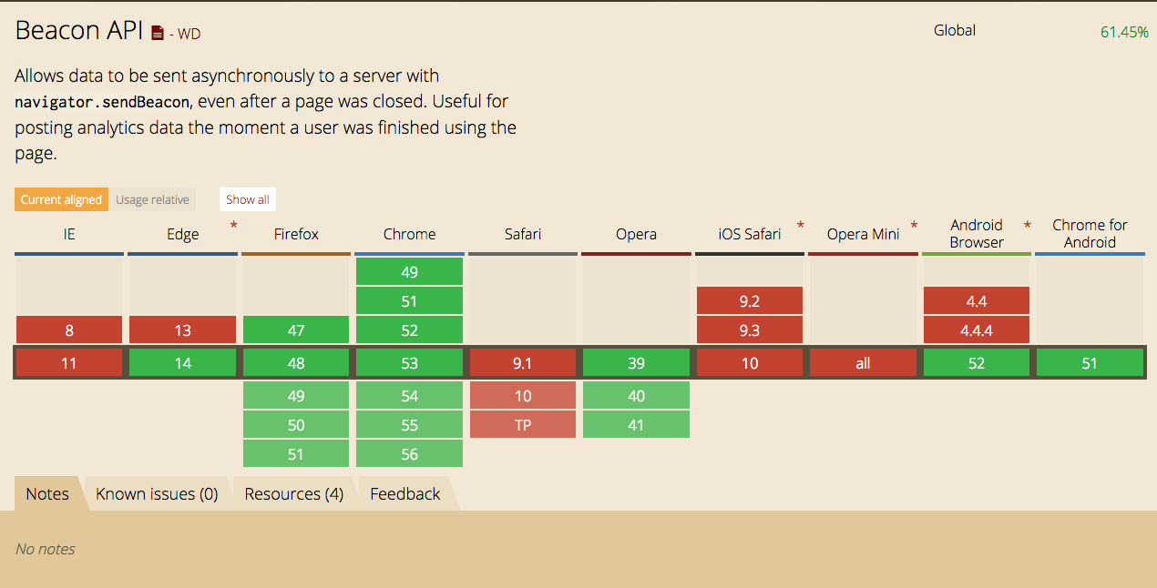
Beacon API: Browser Support

Slide 169
How to Beacon
We recommend:
Use sendBeacon() if available
If not, use Image beacon if < 2,000 bytes
If not, use XMLHttpRequest if available and > 2,000 bytes
If not, consider using FORM beacons or just shrug and move on

Slide 170
When to Beacon
Depends on your use-case:
As soon as you can to be the most reliable
For general analytics:
As soon as you load if you're not waiting for perf metrics
For performance analytics:
After onload or SPA complete to gather all relevant performance metrics
For continuous metrics or session length:
On pagehide if supported
On beforeunload if supported
On unload as a last resort (avoid using sync XHR)

Slide 171
Nixing Noise
getting rid of obviously absurd data

Slide 172
Getting Rid of Noise
Look at simple things like data type & range of all the data you collect
Don't trust client timestamps, only trust deltas
Check for a reasonable rate of data input per client
Validate that your data collector isn't CSRFed
Segregate known bot traffic (well behaved bots)

Slide 173
Some common bogus things we see
All timer values are set to 9999999999
Client timestamps are more than a day, year or 30+ years in the past
Requests that do not change over time
Requests that are very regularly spaced
Client makes exactly the same high valued purchase repeatedly
Page Load time is negative or more than a week long
Measured bandwidth in Terabits/second

Slide 174
Getting Rid of Noise
We also use statistical methods to identify Outliers
Use MAD or Tukey's method to identify data that is outside the expected range
Nelson Rules to check for sufficient randomness
3e-Smoothing to compare actual values with expected values
Don't throw away outliers, analyze them separately
MAD: Median Absolute Deviation: wikipedia://Median_absolute_deviation
John Tukey's fences: datapigtechnologies.com/.../highlighting-outliers-...-with-the-tukey-method/
Nelson Rules: wikipedia://Nelson_rules

Slide 175
Offline First
Measuring without network connectivity

Slide 176
Offline First
ResourceTiming includes workerStart that tells us when a ServiceWorker that intercepted a request started
Our measurement code should also run as a ServiceWorker, queuing up beacons while offline…
But how do we distinguish these queued beacons from forged beacons without an unexpired anti-CSRF token?
This is something we're still experimenting with, so we don't have any concrete recommendations, but we invite you to join the experiment.

Slide 177
W3C WebPerf Working Group
www.w3.org/2010/webperf
Founded in 2010 to give developers the ability to assess and understand performance characteristics of their web apps:
“The mission of the Web Performance Working Group is to provide methods to measure aspects of application performance of user agent features and APIs”
Microsoft, Google, Mozilla, Opera, Facebook, Netflix, Akamai, SOASTA, etc

Slide 178
API Reference
Hi Res Timer https://w3c.github.io/hr-time/
Navigation Timing http://www.w3.org/TR/navigation-timing developer.mozilla.org/.../Web/API/Navigation_timing_API
Resource Timing https://www.w3.org/TR/resource-timing/ developer.mozilla.org/.../Web/API/Resource_Timing_API
Resource Timing Compressor http://nicj.net/compressing-resourcetiming
User Timing https://www.w3.org/TR/user-timing/ developer.mozilla.org/.../Web/API/User_Timing_API
User Timing Polyfill https://github.com/nicjansma/usertiming.js
User Timing Compressor http://nicj.net/compressing-usertiming/
Page Visibility https://w3c.github.io/page-visibility/ developer.mozilla.org/.../Web/API/Page_Visibility_API
Service Workers https://www.w3.org/TR/service-workers/ developer.mozilla.org/.../Web/API/Service_Worker_API
requestAnimationFrame https://www.w3.org/TR/animation-timing/ developer.mozilla.org/.../Web/API/window/requestAnimationFrame
requestIdleCallback https://www.w3.org/TR/requestidlecallback/ developer.mozilla.org/.../Web/API/Window/requestIdleCallback
Spec compliant requestIdleCallback SHIM github://aFarkas/requestIdleCallback
Minimal requestIdleCallback SHIM github://github/requestIdleCallback
Mutation Observer developer.mozilla.org/.../Web/API/MutationObserver
Performance Observer https://www.w3.org/TR/performance-timeline-2/ developer.mozilla.org/.../Web/API/PerformanceObserver
Intersection Observer https://wicg.github.io/IntersectionObserver/ developer.mozilla.org/.../Web/API/Intersection_Observer_API
Beacon API https://w3c.github.io/beacon/ developer.mozilla.org/.../Web/API/Navigator/sendBeacon
W3C Web Performance Working Group http://www.w3.org/2010/webperf

Slide 179
Further Reading
Boomerang https://github.com/SOASTA/boomerang
Andy Davies' Waterfall Bookmarklet https://github.com/andydavies/waterfall
Mark Zeman's Heatmap https://github.com/zeman/perfmap
Progressive Web Metrics https://github.com/paulirish/pwmetrics
Accelerated Mobile Pages https://www.ampproject.org/
The IFrame Loader Technique http://www.lognormal.com/blog/2012/12/12/the-script-loader-pattern/
Affectiva Emotion Analyzer https://github.com/affectiva/youtube-demo
MAD: Median Absolute Deviation https://en.wikipedia.org/wiki/Median_absolute_deviation
John Tukey's fences datapigtechnologies.com/.../highlighting-outliers-...-with-the-tukey-method/
Nelson Rules https://en.wikipedia.org/wiki/Nelson_rules
Exponential Smoothing grisha.org/blog/2016/01/29/triple-exponential-smoothing-forecasting/
Rage Clicking http://blog.fullstory.com/2015/12/reducing-ux-rage-with-fullstorys-rage-clicks/
Inferring Emotion from Mouse Movements telegraph://technology/.../Websites-could-read-emotions-by-...-move-your-mouse.html
Scroll Behaviour http://blog.chartbeat.com/2013/08/12/scroll-behavior-across-the-web/
WebGazer: Eye tracking in JavaScript http://webgazer.cs.brown.edu/
What JavaScript knows about you http://webkay.robinlinus.com/
Video Metrics https://wiki.whatwg.org/wiki/Video_Metrics
The Runtime Performance Checklist http://calendar.perfplanet.com/2013/the-runtime-performance-checklist/
Jank Meter https://webperf.ninja/2015/jank-meter/
RAIL Performance Audit of SFGate.com https://docs.google.com/document/d/1K-mKOqiUiSjgZTEscBLjtjd6E67oiK8H2ztOiq5tigk
Debouncing and Throttling Events https://css-tricks.com/debouncing-throttling-explained-examples/

Slide 180
Photo Credits
Angel Delight by Auntie P https://www.flickr.com/photos/auntiep/360764980/
Frustrated by Kevin Lawver https://www.flickr.com/photos/kplawver/1903240219/

Slide 181
Thank You
http://slideshare.net/nicjansma/measuring-real-user-performance-in-the-browser
Notes:
The colours are of the French Flag

Slide 182
Philip Tellis
@bluesmoon
Nic Jansma
@nicj
https://github.com/SOASTA/boomerang
http://www.soasta.com/mpulse
http://slideshare.net/nicjansma/measuring-real-user-performance-in-the-browser

